Slide 1

Visualize Data with

Slide 2

(Applied) Data Science
Visualize
Import
Tidy
Model
Communicate
Transform
Program

Slide 3
"The simple graph has brought more information to the data analyst’s mind than any other device. "
- John Tukey

Slide 4
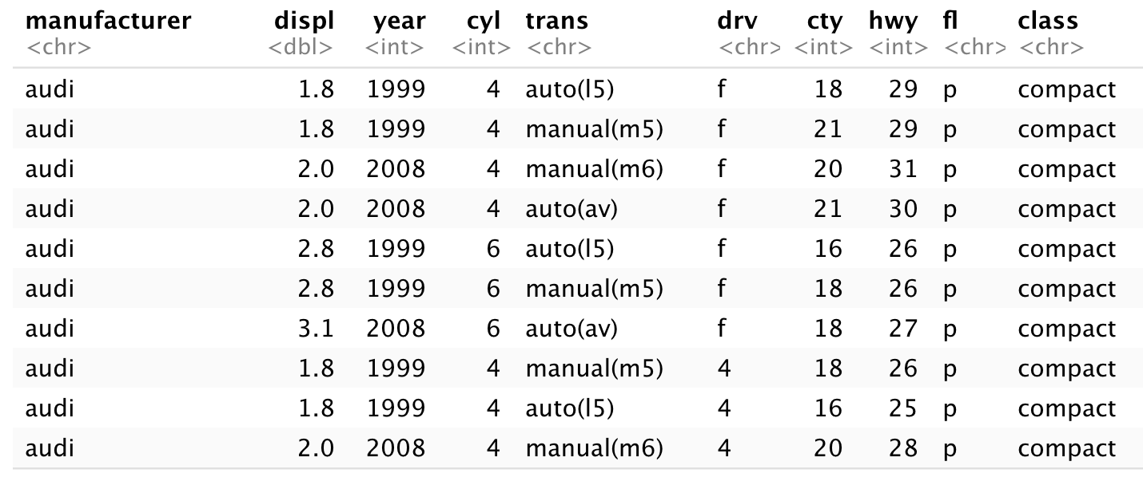
mpg
Fuel economy data for 38 models of car.
mpg

Slide 5

Quiz
Confer with your group.
What relationship do you expect to see between engine size (displ) and mileage (hwy)?
No peeking ahead!

Slide 6

Your Turn 1
Run this code in 02-Visualize-Exercises.Rmd to make a graph. Pay strict attention to spelling, capitalization, and parentheses!
ggplot(data = mpg) +
geom_point(mapping = aes(x = displ, y = hwy))

Slide 7
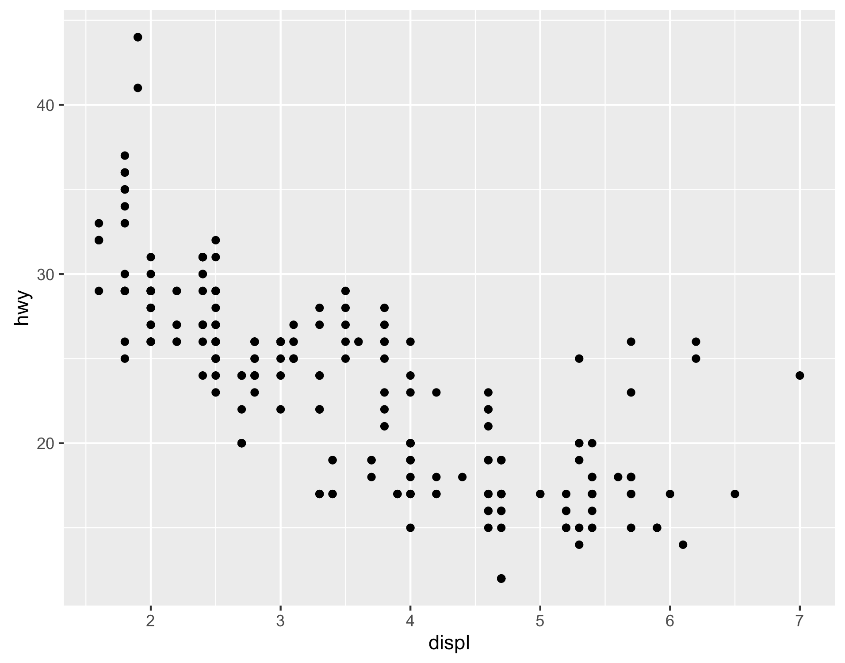
ggplot(data = mpg) +
geom_point(mapping = aes(x = displ, y = hwy))

Slide 8
"Initialize" a plot with ggplot()
Add layers with geom_ functions
ggplot(data = mpg) +
geom_point(mapping = aes(x = displ, y = hwy))

Slide 9
Pro tip: Always put the + at the end of a line, Never at the start
ggplot(data = mpg) +
geom_point(mapping = aes(x = displ, y = hwy))

Slide 10
data
+ before new line
ggplot(data = mpg) +
geom_point(mapping = aes(x = displ, y = hwy))
type of layer
aes()
x variable
y variable

Slide 11
A template
ggplot(data = <DATA>) +
<GEOM_FUNCTION>(mapping = aes(<MAPPINGS>))
ggplot(data = mpg) +
geom_point(mapping = aes(x = displ, y = hwy))

Slide 12
A template
ggplot(data = <DATA>) +
<GEOM_FUNCTION>(mapping = aes(<MAPPINGS>))

Slide 13

Mappings

Slide 14
"The greatest value of a picture is when it forces us to notice what we never expected to see."
- John Tukey

Slide 15
How can we test the theory?
Why do these cars get better mileage?
ggplot(data = mpg) +
geom_point(mapping = aes(x = displ, y = hwy))

Slide 16
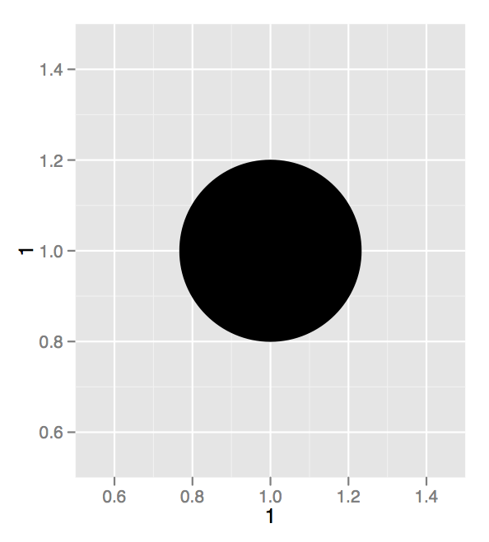
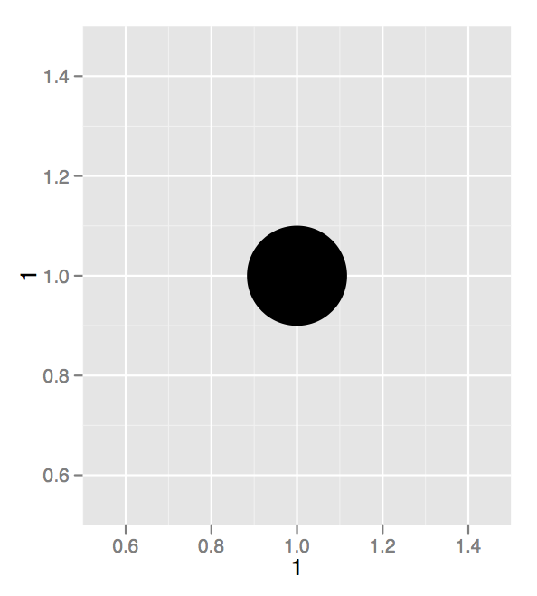
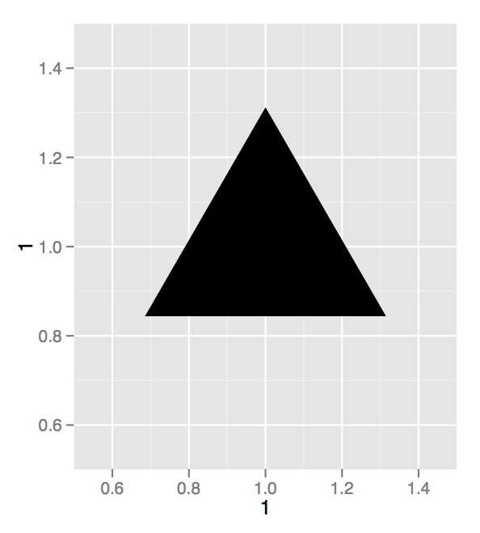
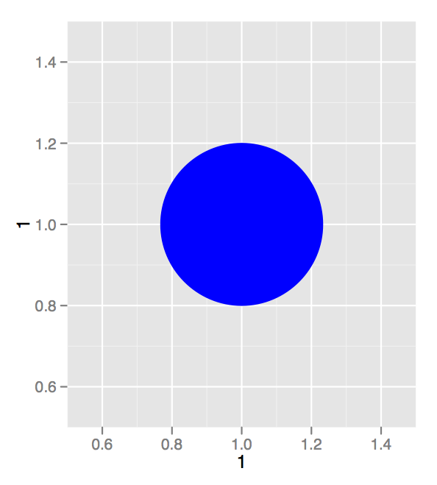
Aesthetics

Slide 17
Visual Space
Data Space
color
class
Red
Brown
Green
Aqua
Blue
Violet
Pink
2seater
compact
midsize
minivan
pickup
subcompact
suv

Slide 18
Aesthetics
aesthetic property
Variable to map it to
ggplot(mpg) + geom_point(aes(x = displ, y = hwy, color = class))
ggplot(mpg) + geom_point(aes(x = displ, y = hwy, size = class))
ggplot(mpg) + geom_point(aes(x = displ, y = hwy, shape = class))
ggplot(mpg) + geom_point(aes(x = displ, y = hwy, alpha = class))

Slide 19

Your Turn 2
In the next chunk, add color, size, alpha, and shape aesthetics to your graph. Experiment.
Do different things happen when you map aesthetics to discrete and continuous variables?
What happens when you use more than one aesthetic?

Slide 20
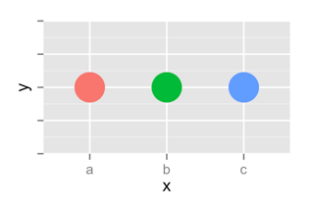
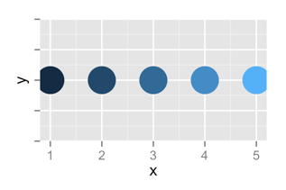
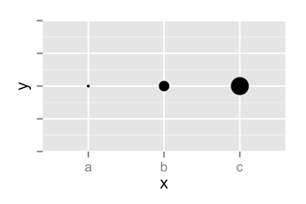
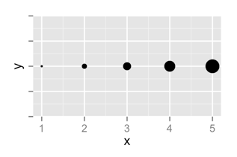
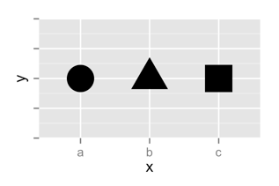
 | Discrete | Continuous
Color
Size
Shape

Slide 21
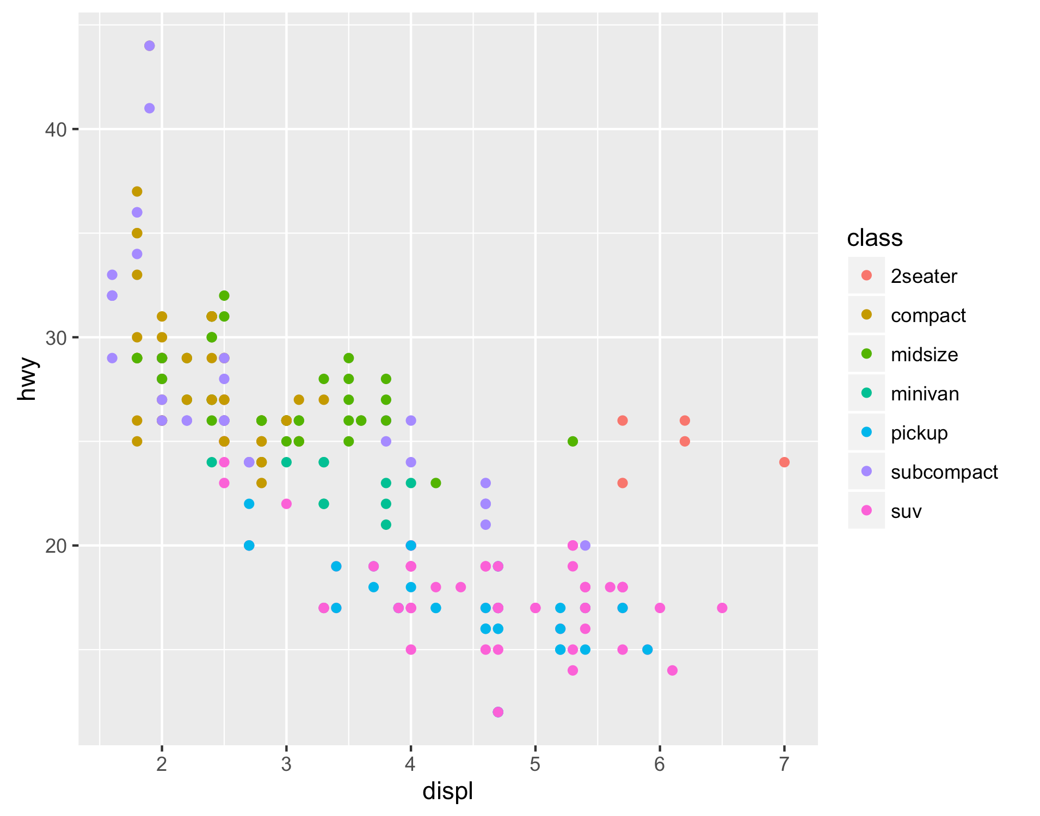
Legend added automatically
ggplot(data = mpg) +
geom_point(mapping = aes(x = displ, y = hwy, color = class))

Slide 22
Error!
ggplot(data = mpg) +
geom_point(mapping = aes(x = displ, y = hwy), color = class)

Slide 23
Facets

Slide 24
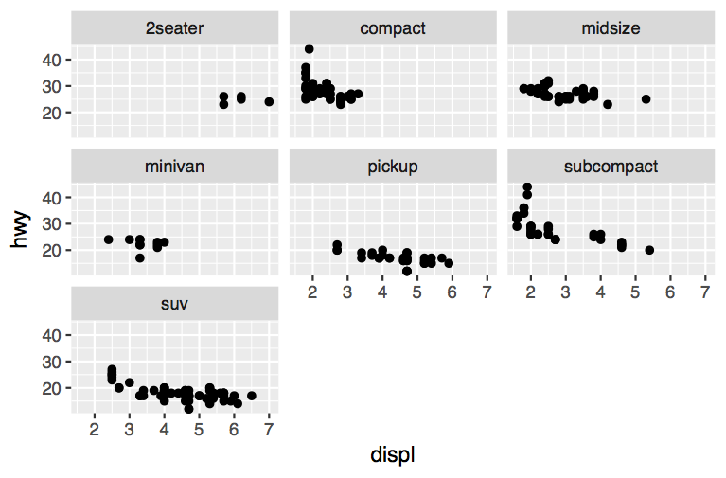
Facets
Subplots that display subsets of the data.
CC by RStudio

Slide 25
Help me
What do facet_grid and facet_wrap do?
q <- ggplot(mpg) + geom_point(aes(x = displ, y = hwy))
q + facet_grid(. ~ cyl)
q + facet_grid(drv ~ .)
q + facet_grid(drv ~ cyl)
q + facet_wrap(~ class)

Slide 26
summary
facet_grid() - 2D grid, rows ~ cols, . for no split
facet_wrap() - 1D ribbon wrapped into 2D
CC by RStudio

Slide 27
A ggplot2 template
Make any plot by filling in the parameters of this template
ggplot(data = <DATA>) +
<GEOM_FUNCTION>(mapping = aes(<MAPPINGS>)) +
<FACET_FUNCTION>
CC by RStudio

Slide 28
Geoms

Slide 29
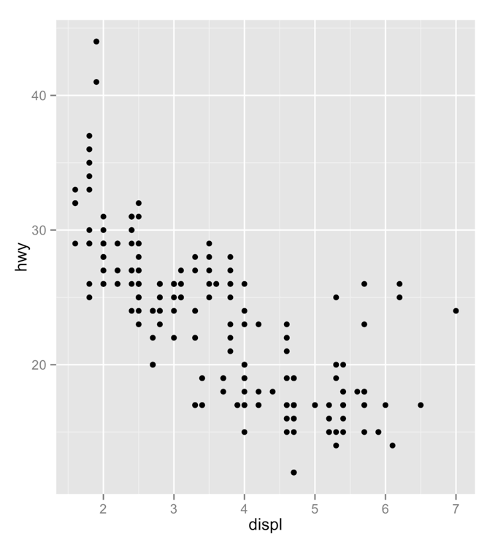
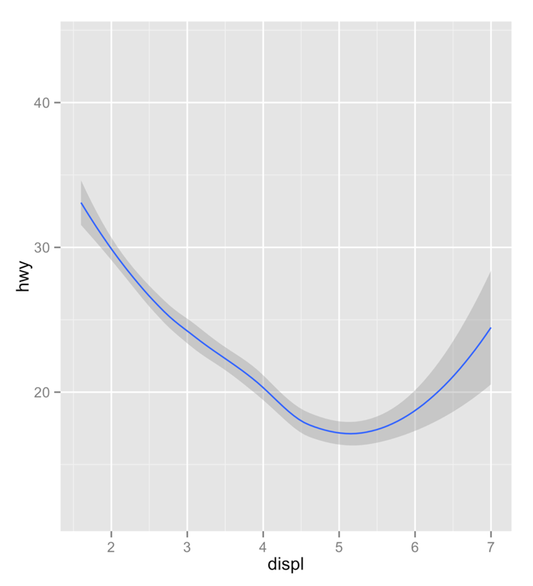
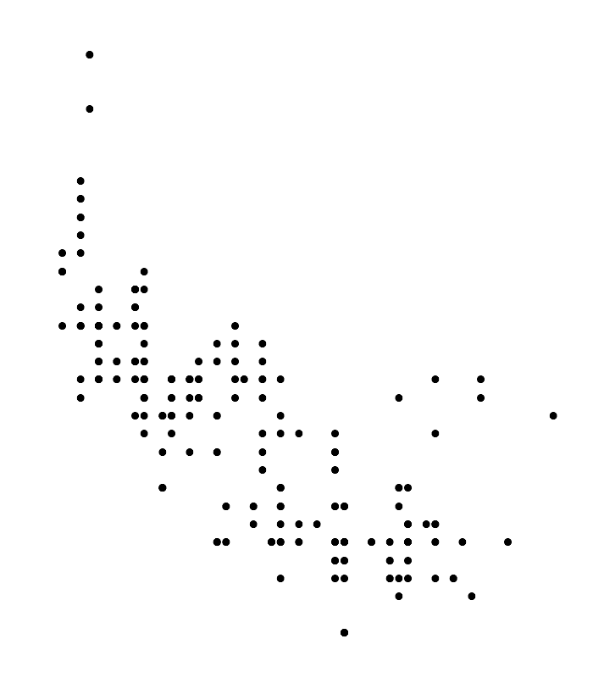
How are these plots similar?
Same:
x var
, y var
, data

Slide 30
How are these plots different?
Different: geometric object (geom),
e.g. the visual object used to represent the data

Slide 31
geoms
ggplot(data = <DATA>) +
<GEOM_FUNCTION>(mapping = aes(<MAPPINGS>))

Slide 32


rstudio.cloud/learn/cheat-sheets
Click
CheAT Sheets
in the sidebar

Slide 33
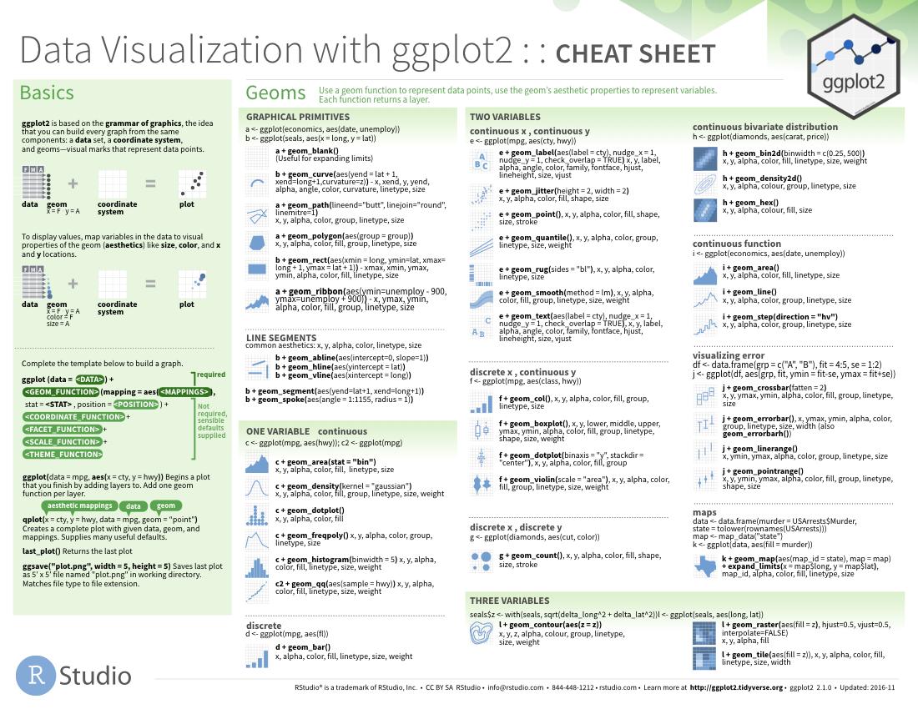
geom_ functions
Each requires a mapping argument.

Slide 34

Your Turn
Pair up.

Slide 35
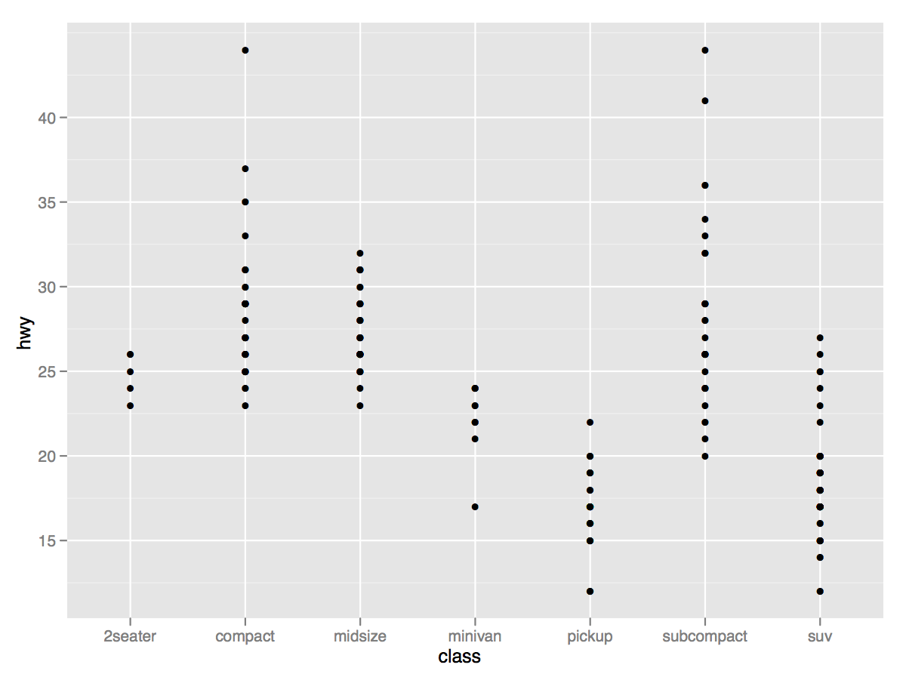
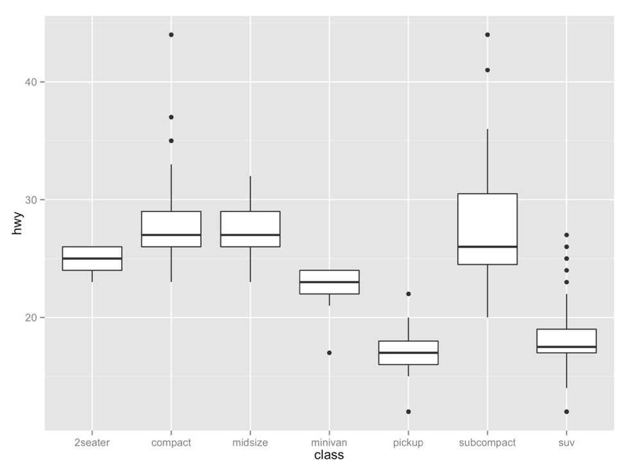
Your Turn 3
With your partner, decide how to replace this scatterplot with one that draws boxplots. Use the cheatsheet. Try your best guess.
ggplot(mpg) + geom_point(aes(class, hwy))

Slide 36
ggplot(data = mpg) +
geom_boxplot(mapping = aes(x = class, y = hwy))

Slide 37
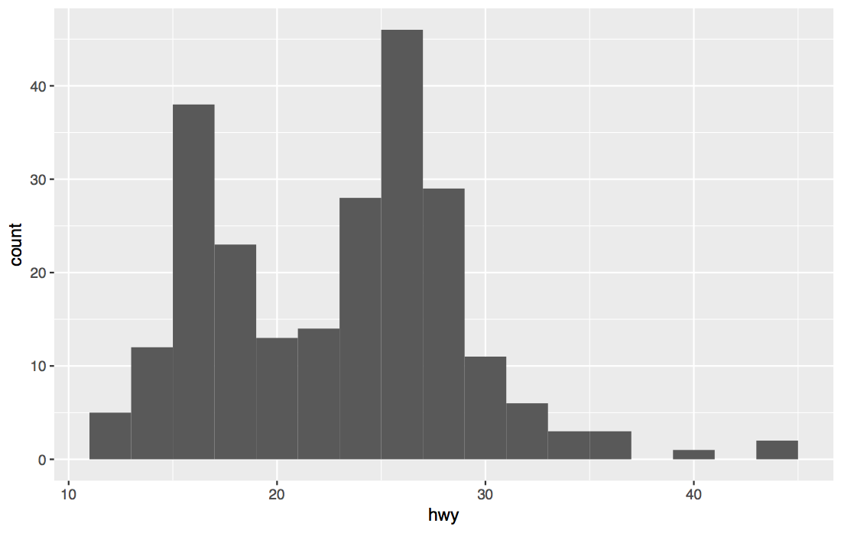
Your Turn 4
With a partner, make the histogram of hwy below. Use the cheatsheet. Hint: do not supply a y variable.

Slide 38
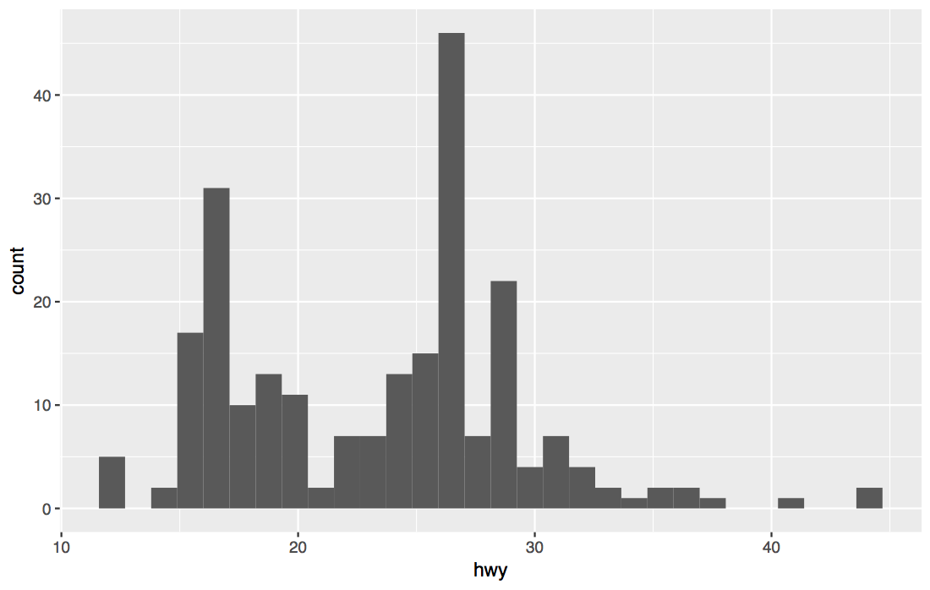
ggplot(data = mpg) +
geom_histogram(mapping = aes(x = hwy))

Slide 39
Quiz
What is the difference?

Slide 40
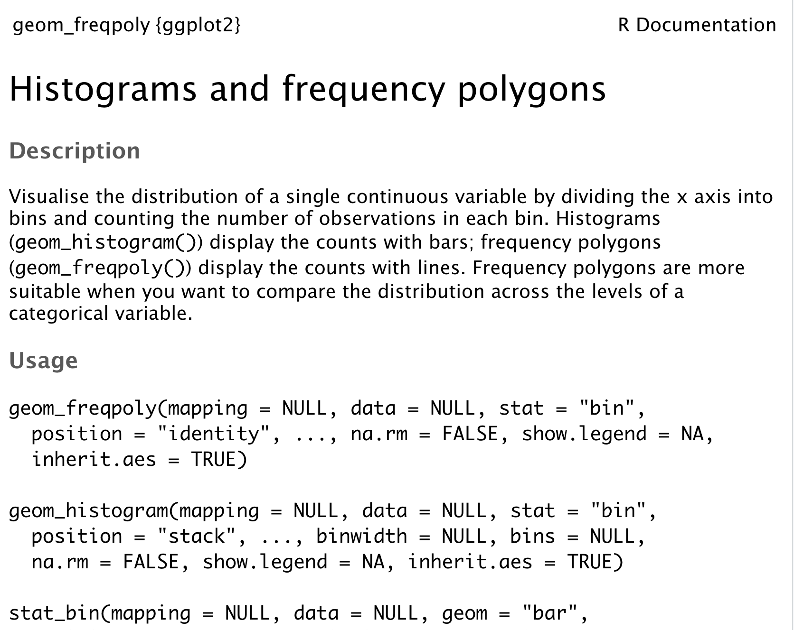
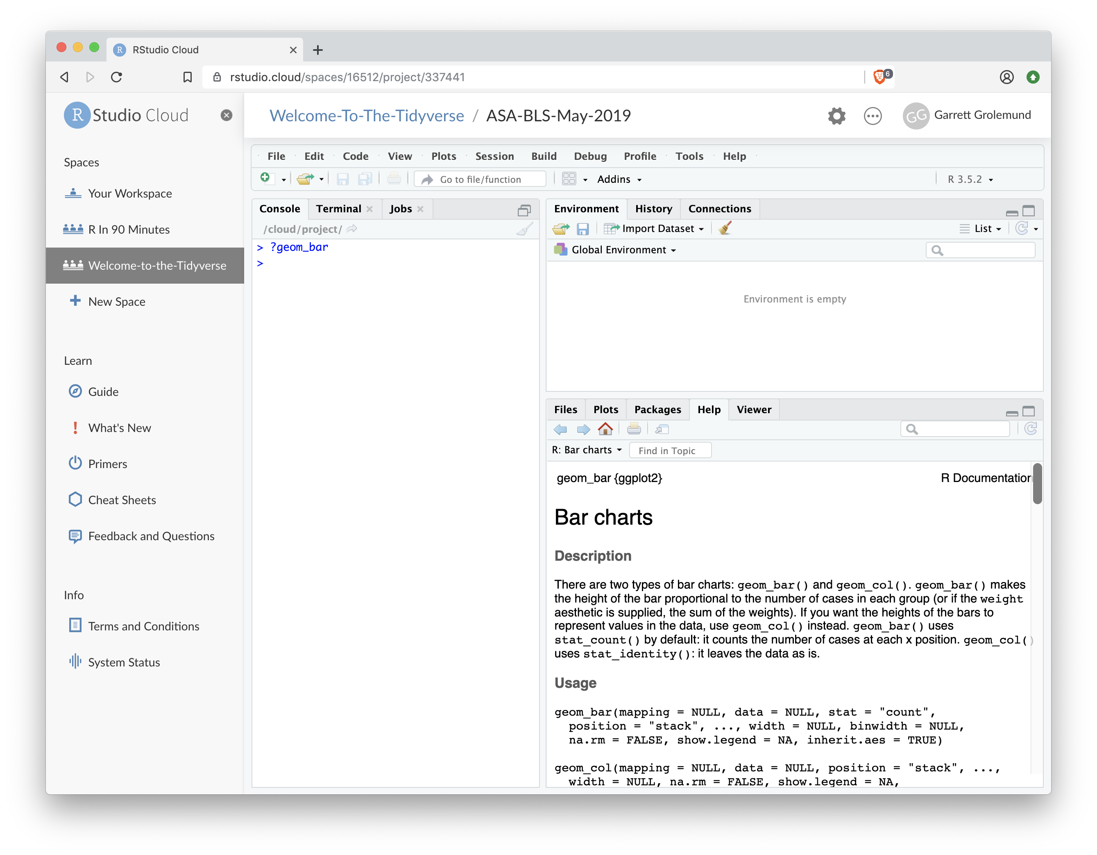
"Help" pages
To open the documentation for a function, type
?geom_histogram
?
function name (no parentheses)

Slide 41
Tips
scan page for relevant info
ignore things that don't make sense
try out the examples

Slide 42
Your Turn 5
Use the help page for geom_histogram to make the bins 2 mpg wide.

Slide 43
ggplot(data = mpg) +
geom_histogram(mapping = aes(x = hwy), binwidth = 2)

Slide 44
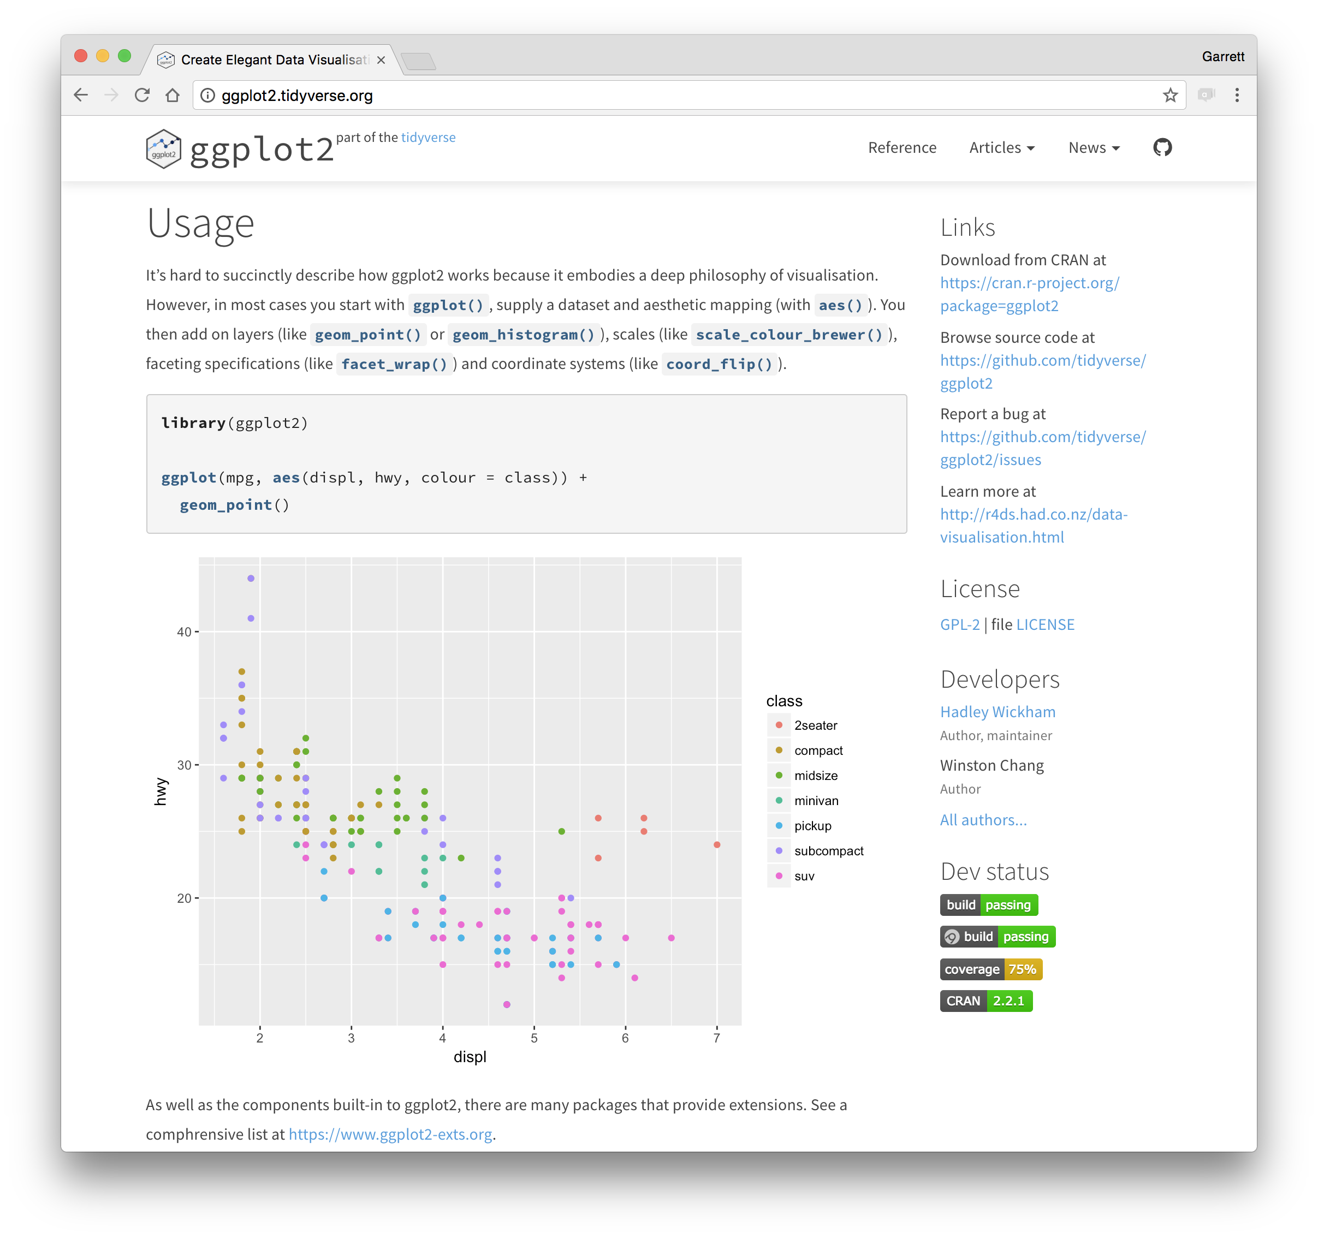
ggplot2.tidyverse.org

Slide 45
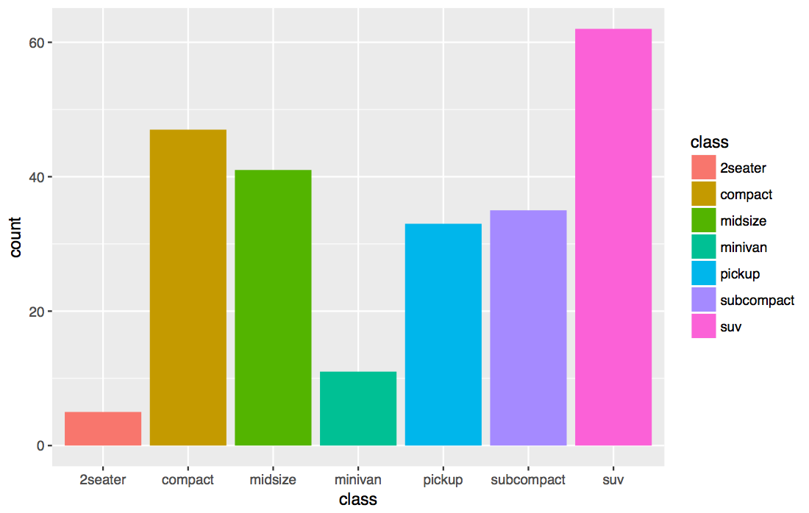
Your Turn 6
With a partner, make the bar chart of class below. Use the cheatsheet. Hint: do not supply a y variable.

Slide 46
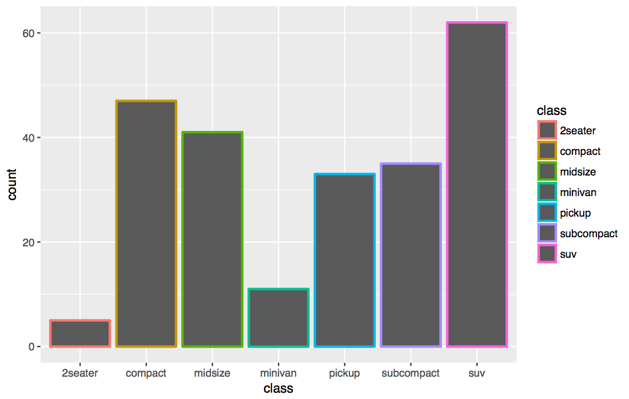
ggplot(data = mpg) +
geom_bar(mapping = aes(x = class, color = class))

Slide 47
ggplot(data = mpg) +
geom_bar(mapping = aes(x = class, fill = class))

Slide 48
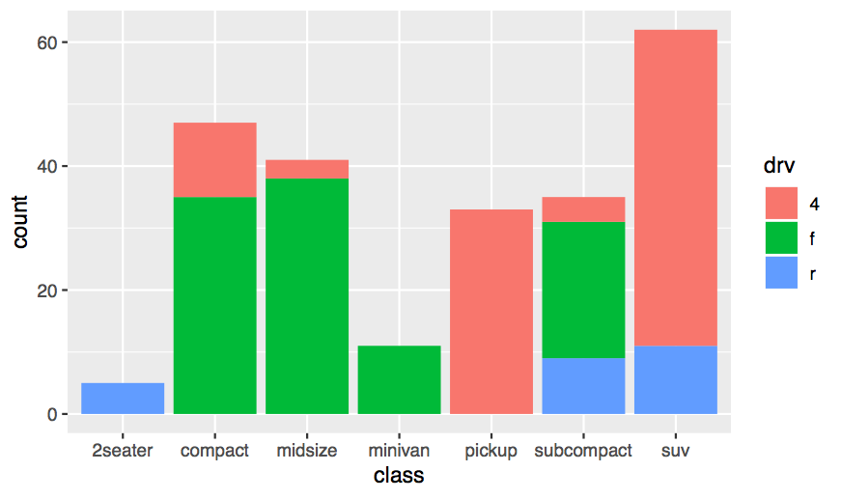
ggplot(data = mpg) +
geom_bar(mapping = aes(x = class, fill = drv))

Slide 49
Quiz
What will this code do?
ggplot(mpg) +
geom_point(aes(displ, hwy)) +
geom_smooth(aes(displ, hwy))

Slide 50
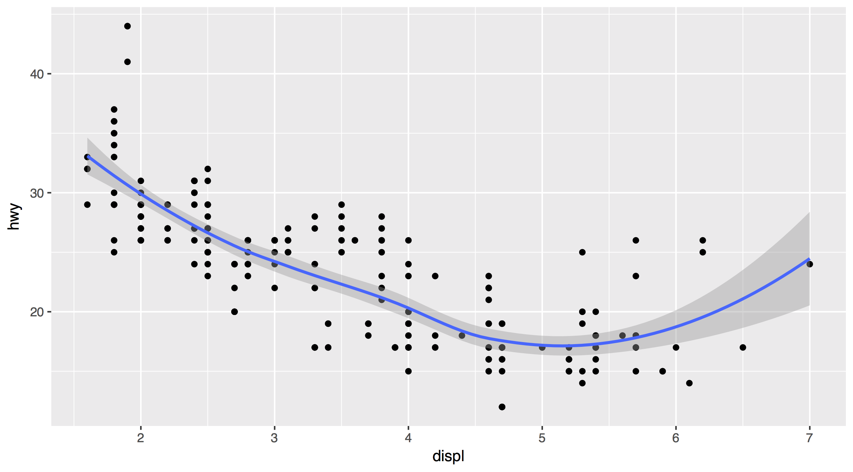
Each new geom adds a new layer
ggplot(data = mpg) +
geom_point(mapping = aes(x = displ, y = hwy)) +
geom_smooth(mapping = aes(x = displ, y = hwy))

Slide 51
Each new geom adds a new layer
ggplot(data = mpg) +
geom_point(mapping = aes(x = displ, y = hwy)) +
geom_smooth(mapping = aes(x = displ, y = hwy))

Slide 52
global vs. local

Slide 53
Mappings (and data) that appear in ggplot() will apply globally to every layer
ggplot(data = mpg, mapping = aes(x = displ, y = hwy)) +
geom_point() +
geom_smooth()

Slide 54
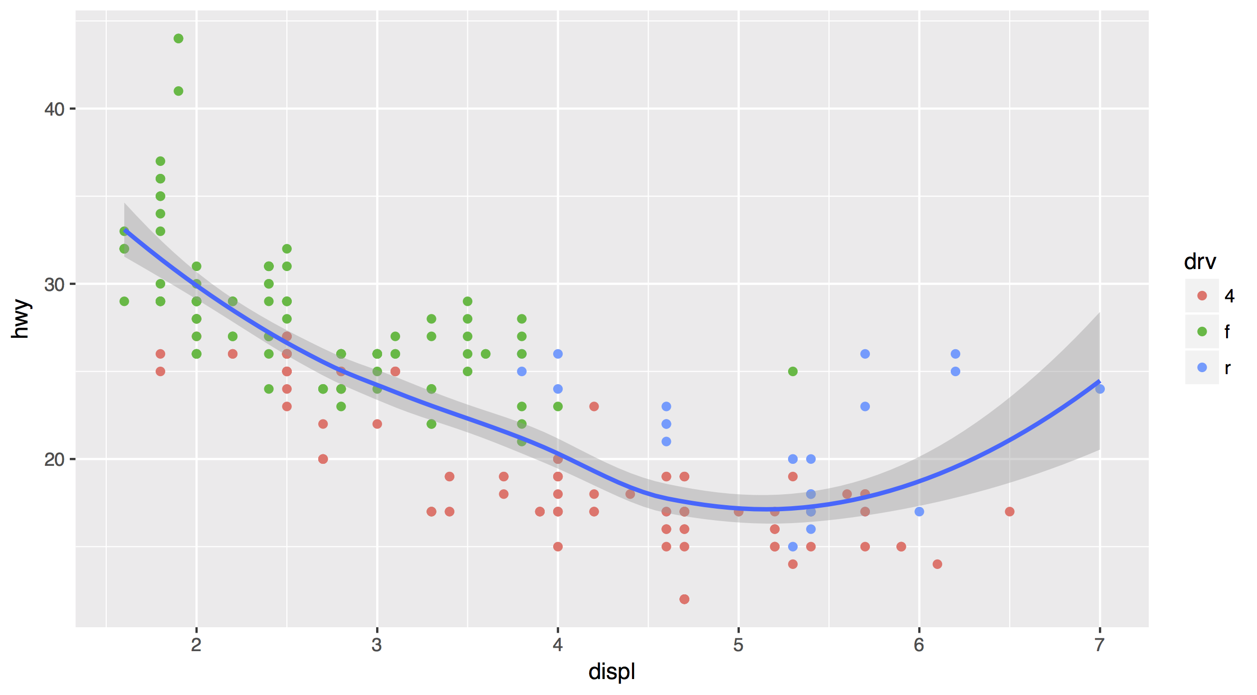
Mappings (and data) that appear in a geom_ function will add to or override the global mappings for that layer only
ggplot(data = mpg, mapping = aes(x = displ, y = hwy)) +
geom_point(mapping = aes(color = drv)) +
geom_smooth()

Slide 55
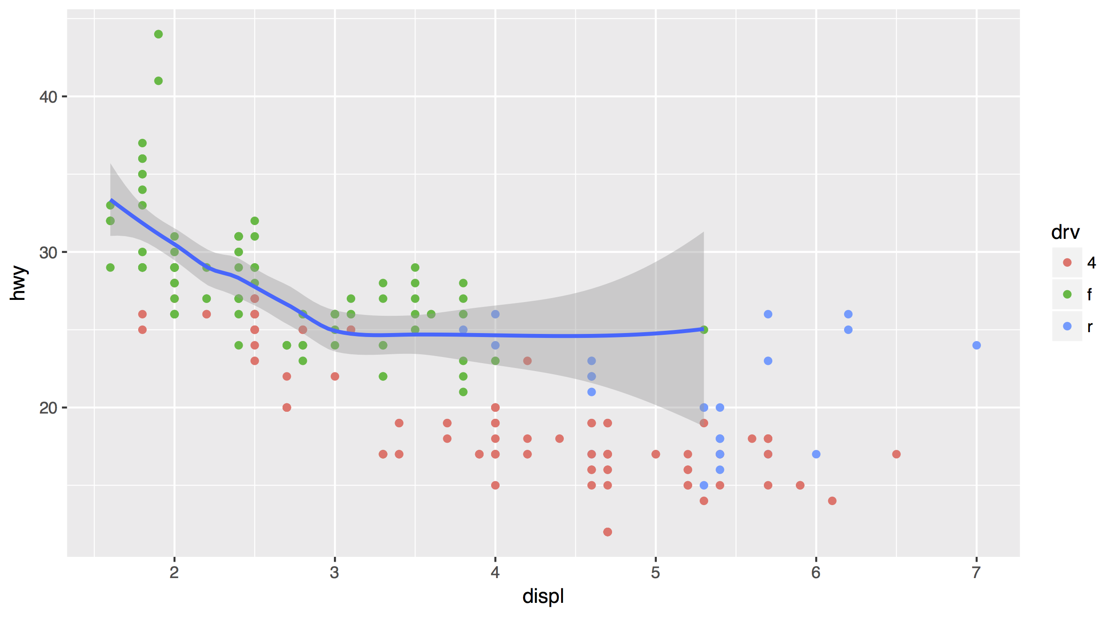
data can also be set locally or globally
ggplot(data = mpg, mapping = aes(x = displ, y = hwy)) +
geom_point(mapping = aes(color = drv)) +
geom_smooth(data = filter(mpg, drv == "f"))

Slide 56
Quiz
What is different about this plot? Run the code!
p <- ggplot(mpg) +
geom_point(aes(displ, hwy)) +
geom_smooth(aes(displ, hwy))
library(plotly)
ggplotly(p)

Slide 57
interactivity

Slide 58
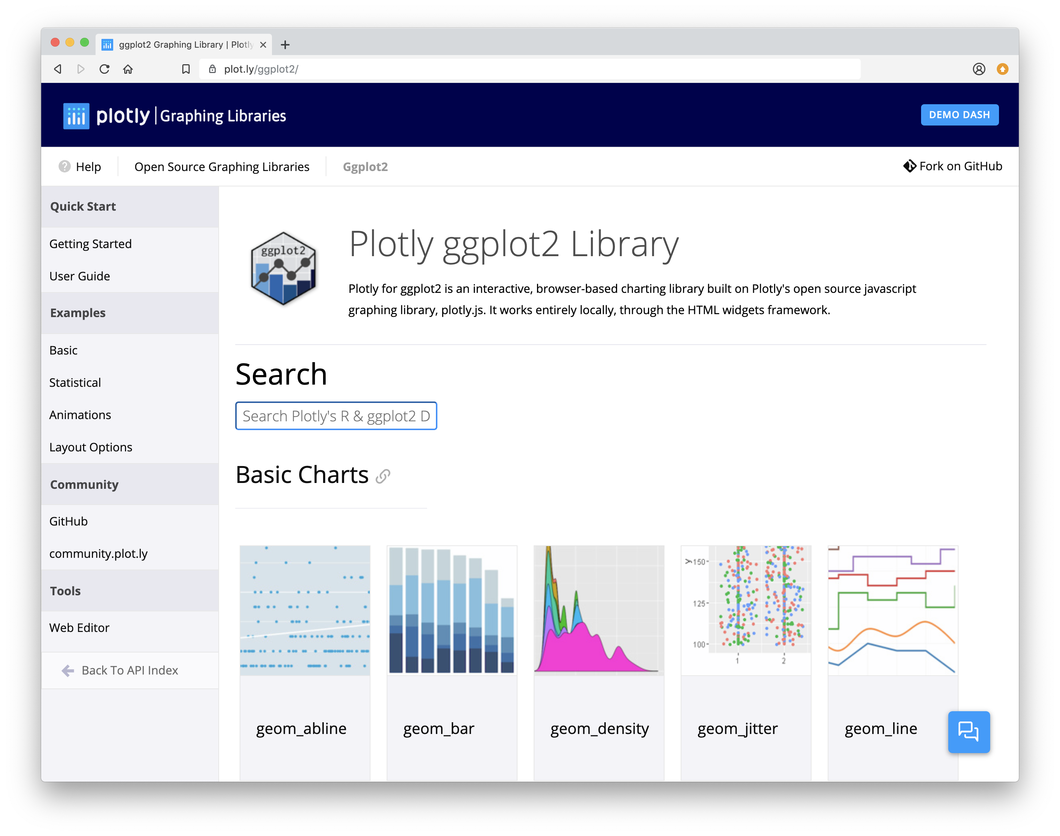
Plotly
Tools for making interactive plots. plot.ly/ggplot2/

Slide 59
Saving
graphs

Slide 60
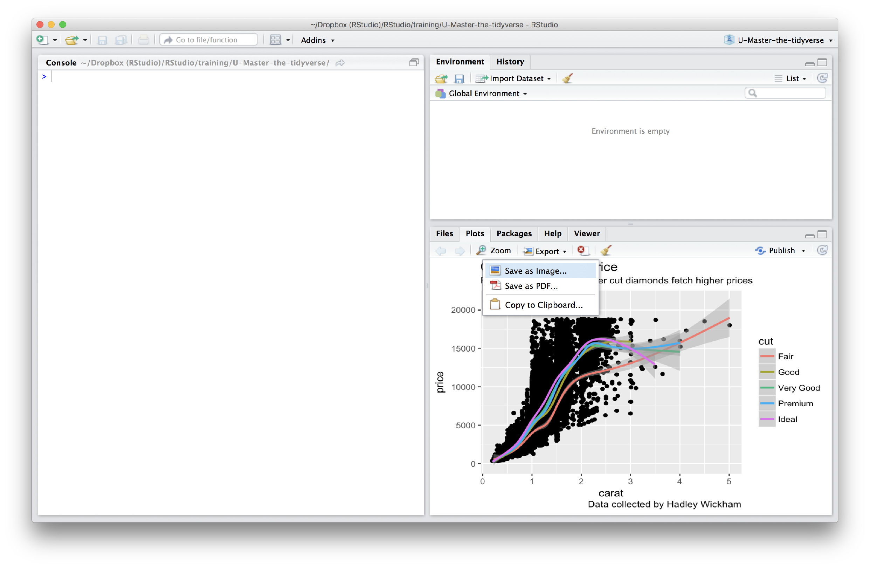
Manually saving plots
Save plots manually with the export menu

Slide 61
Saving plots
ggsave() saves the last plot.
Uses size on screen:
ggsave("my-plot.pdf")
ggsave("my-plot.png")
But where will
it save it?
Specify size in inches
ggsave("my-plot.pdf", width = 6, height = 6)

Slide 62
Your Turn 7
What does this command return?
getwd()

Slide 63
Working directory
R associates itself with a folder (i.e. directory) on your computer.
This folder is known as your "working directory"
When you save files, R will save them here
When you load files, R will look for them here

Slide 64
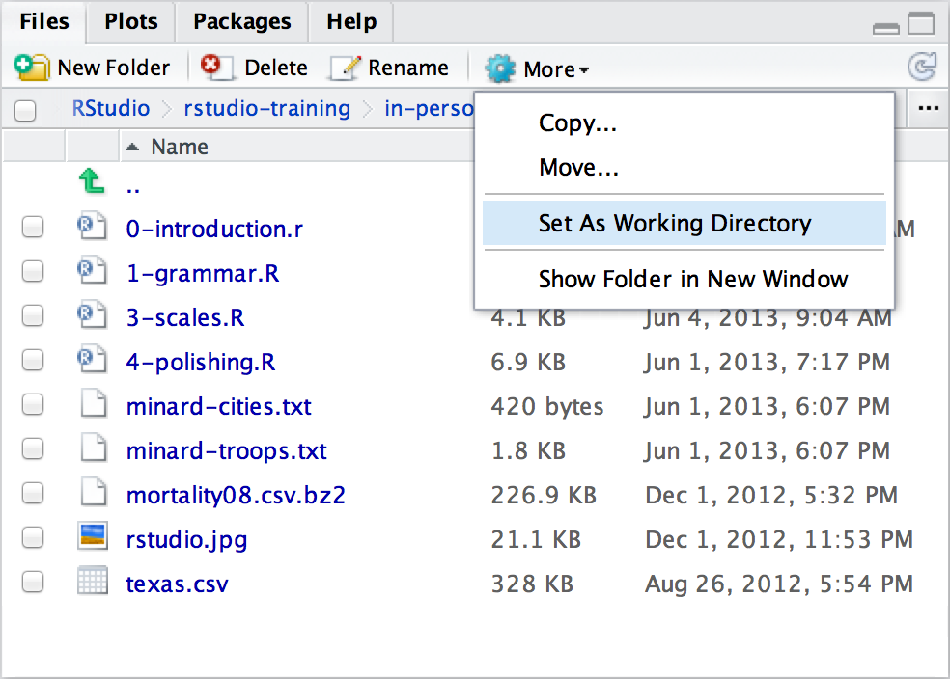
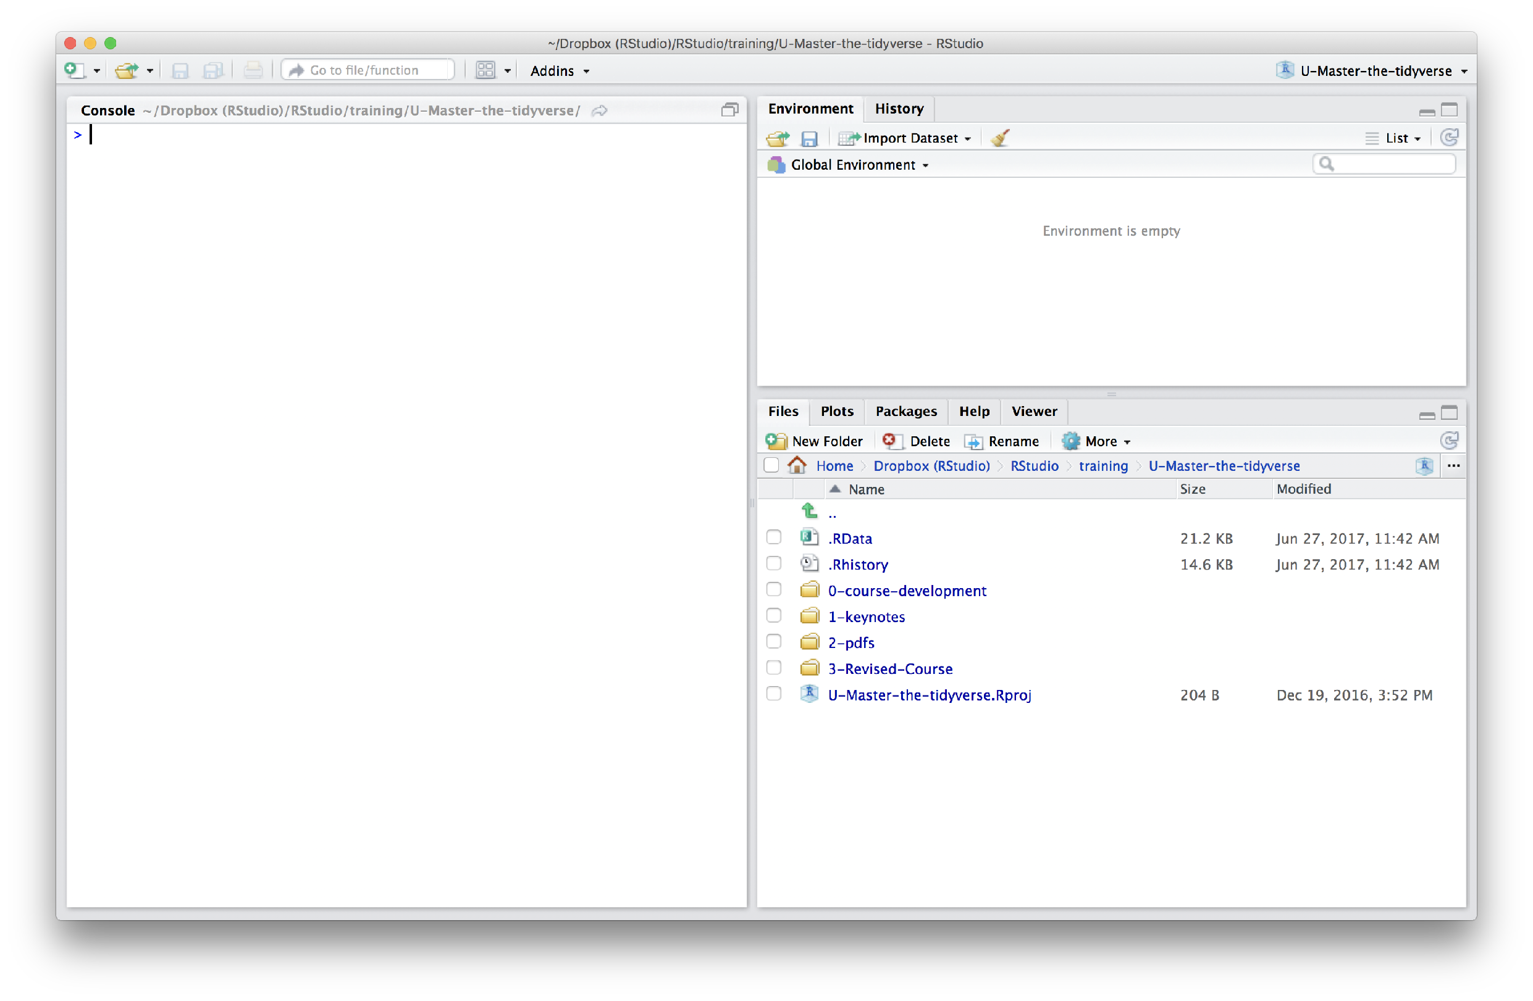
Changing the Working directory
Navigate in the files pane to a new directory. Click
More > Set As Working Directory

Slide 65
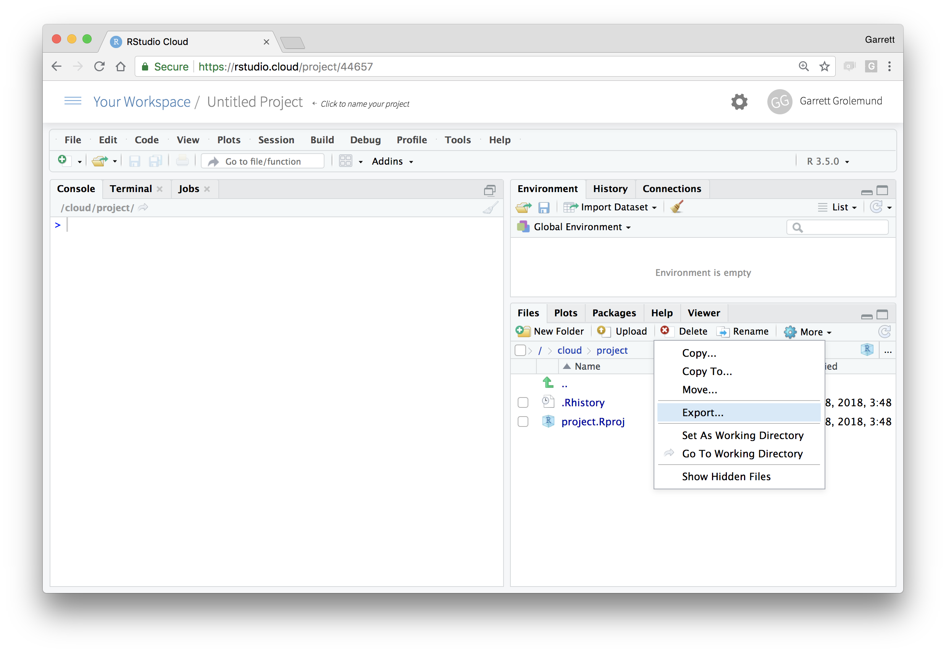
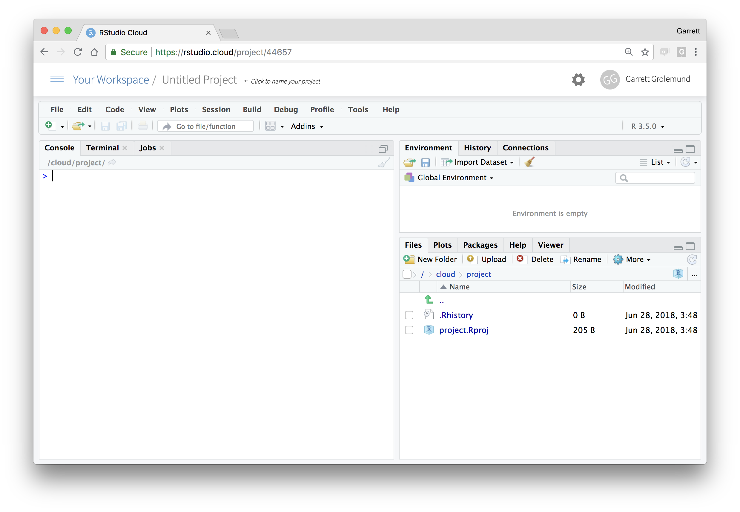
Download files
In the files pane, check next to the file(s) to download
More > Export

Slide 66
Plotly
Save with
htmlwidgets::saveWidget()
Tools for making interactive plots. plot.ly/ggplot2/

Slide 67
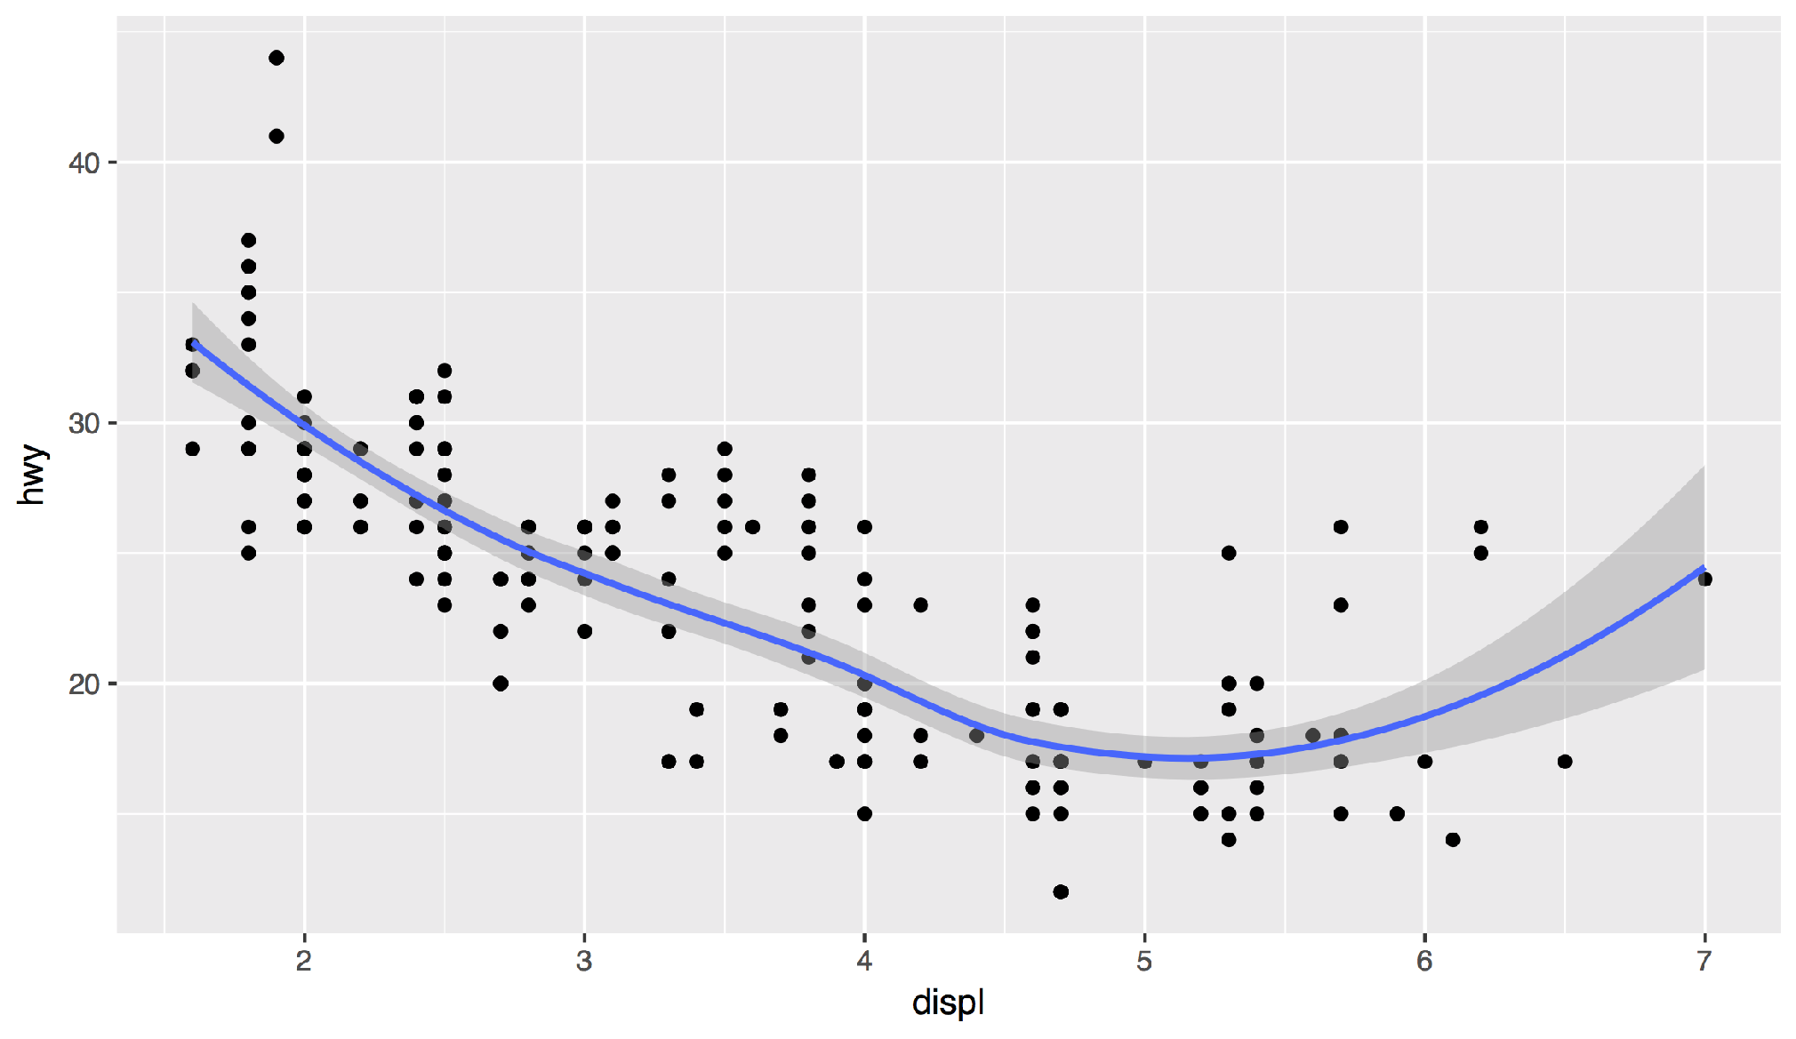
Your Turn 8
Save your last plot and then locate it in your files pane and download it. (You may have to refresh the files list).

Slide 68
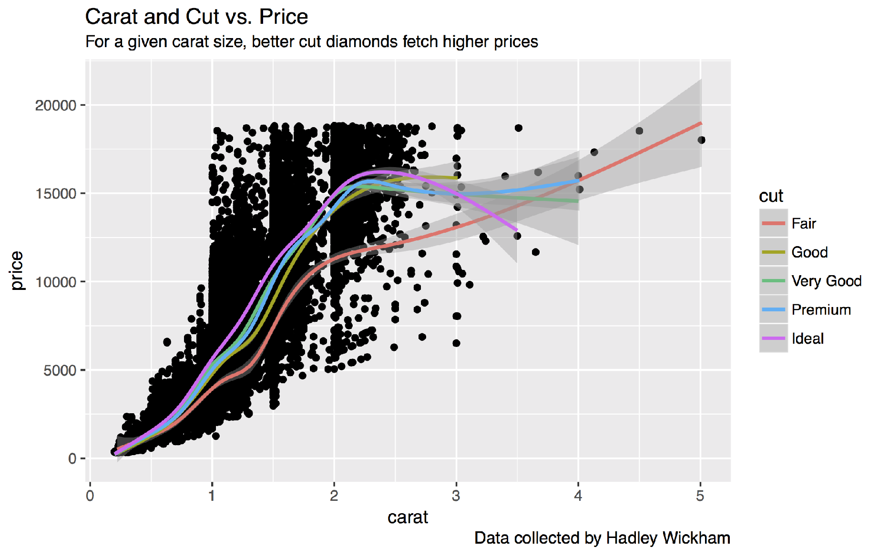
Your turn
Save your last plot and then locate it in your files pane.

Slide 69
Grammar
of Graphics

Slide 70
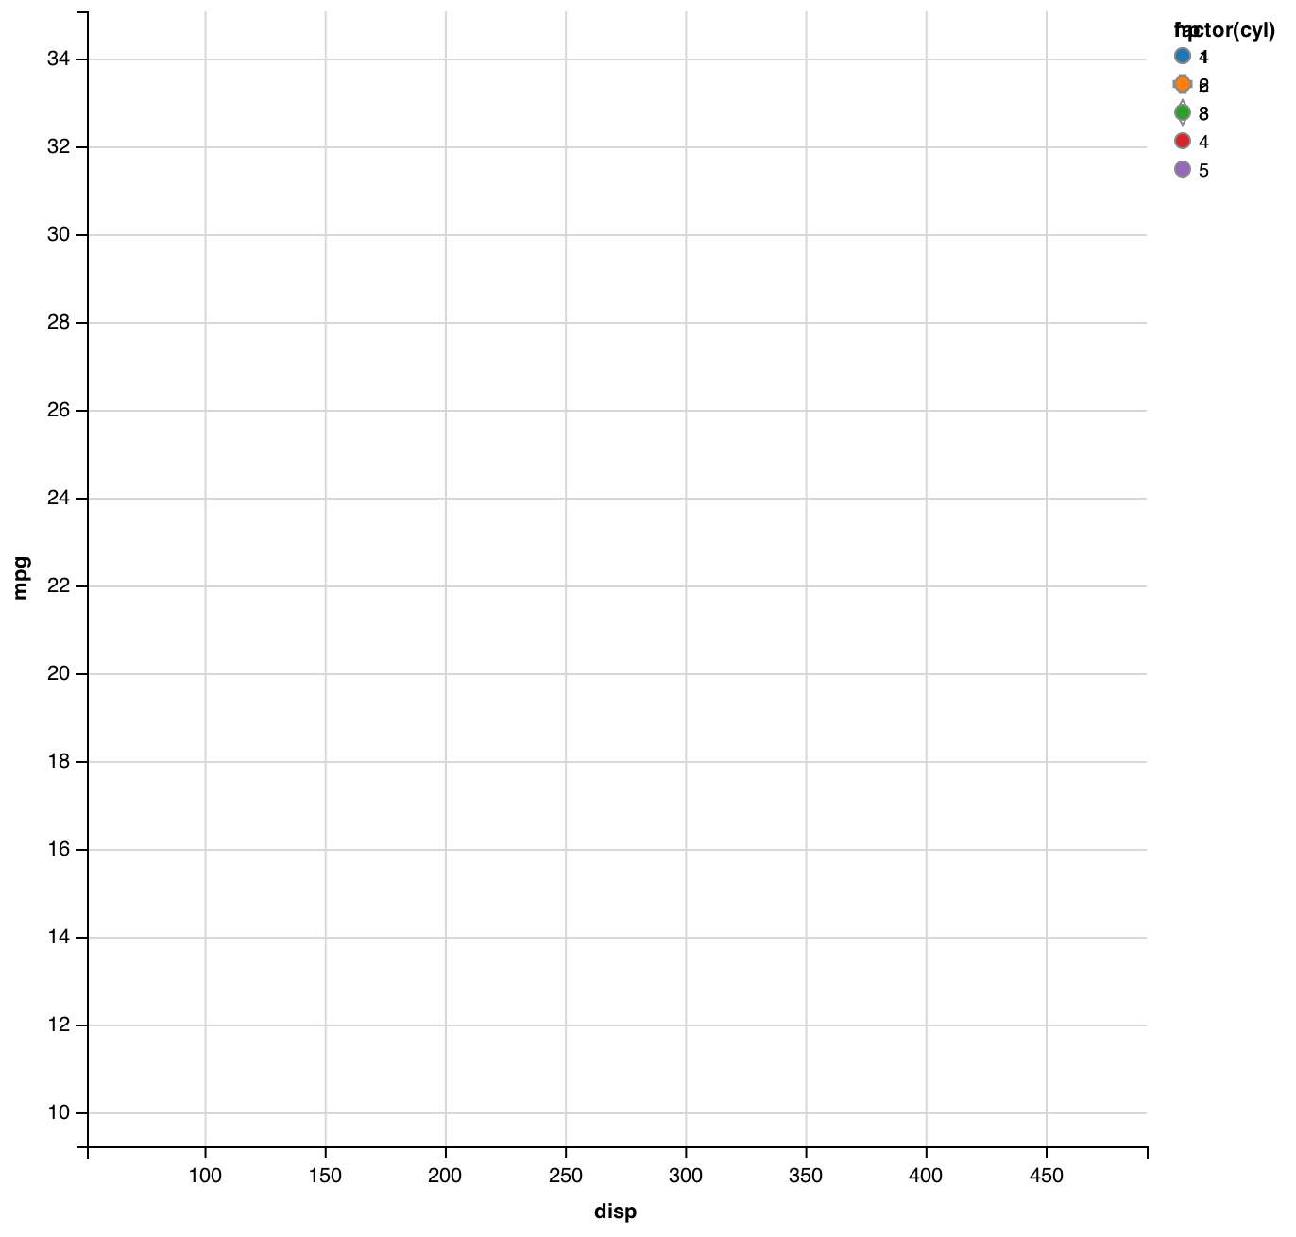
mpg | cyl | disp | hp
21.0 | 6 | 160.0 | 2
21.0 | 6 | 160.0 | 2
22.8 | 4 | 108.0 | 1
21.4 | 6 | 258.0 | 2
18.7 | 8 | 360.0 | 3
18.1 | 6 | 225.0 | 2
14.3 | 8 | 360.0 | 5
24.4 | 4 | 146.7 | 1
22.8 | 4 | 140.8 | 1
19.2 | 6 | 167.6 | 2
17.8 | 6 | 167.6 | 2
16.4 | 8 | 275.8 | 3
17.3 | 8 | 275.8 | 3
15.2 | 8 | 275.8 | 3
10.4 | 8 | 472.0 | 4
10.4 | 8 | 460.0 | 4
14.7 | 8 | 440.0 | 4
32.4 | 4 | 78.7 | 1
30.4 | 4 | 75.7 | 1
33.9 | 4 | 71.1 | 1
data
geom

Slide 71
mappings
fill
mpg | cyl | disp | hp
21.0 | 6 | 160.0 | 2
21.0 | 6 | 160.0 | 2
22.8 | 4 | 108.0 | 1
21.4 | 6 | 258.0 | 2
18.7 | 8 | 360.0 | 3
18.1 | 6 | 225.0 | 2
14.3 | 8 | 360.0 | 5
24.4 | 4 | 146.7 | 1
22.8 | 4 | 140.8 | 1
19.2 | 6 | 167.6 | 2
17.8 | 6 | 167.6 | 2
16.4 | 8 | 275.8 | 3
17.3 | 8 | 275.8 | 3
15.2 | 8 | 275.8 | 3
10.4 | 8 | 472.0 | 4
10.4 | 8 | 460.0 | 4
14.7 | 8 | 440.0 | 4
32.4 | 4 | 78.7 | 1
30.4 | 4 | 75.7 | 1
33.9 | 4 | 71.1 | 1
data
geom

Slide 72
mappings
shape
fill
mpg | cyl | disp | hp
21.0 | 6 | 160.0 | 2
21.0 | 6 | 160.0 | 2
22.8 | 4 | 108.0 | 1
21.4 | 6 | 258.0 | 2
18.7 | 8 | 360.0 | 3
18.1 | 6 | 225.0 | 2
14.3 | 8 | 360.0 | 5
24.4 | 4 | 146.7 | 1
22.8 | 4 | 140.8 | 1
19.2 | 6 | 167.6 | 2
17.8 | 6 | 167.6 | 2
16.4 | 8 | 275.8 | 3
17.3 | 8 | 275.8 | 3
15.2 | 8 | 275.8 | 3
10.4 | 8 | 472.0 | 4
10.4 | 8 | 460.0 | 4
14.7 | 8 | 440.0 | 4
32.4 | 4 | 78.7 | 1
30.4 | 4 | 75.7 | 1
33.9 | 4 | 71.1 | 1
data
geom

Slide 73
mappings
shape
x
fill
mpg | cyl | disp | hp
21.0 | 6 | 160.0 | 2
21.0 | 6 | 160.0 | 2
22.8 | 4 | 108.0 | 1
21.4 | 6 | 258.0 | 2
18.7 | 8 | 360.0 | 3
18.1 | 6 | 225.0 | 2
14.3 | 8 | 360.0 | 5
24.4 | 4 | 146.7 | 1
22.8 | 4 | 140.8 | 1
19.2 | 6 | 167.6 | 2
17.8 | 6 | 167.6 | 2
16.4 | 8 | 275.8 | 3
17.3 | 8 | 275.8 | 3
15.2 | 8 | 275.8 | 3
10.4 | 8 | 472.0 | 4
10.4 | 8 | 460.0 | 4
14.7 | 8 | 440.0 | 4
32.4 | 4 | 78.7 | 1
30.4 | 4 | 75.7 | 1
33.9 | 4 | 71.1 | 1
data
geom

Slide 74
mappings
y
shape
x
fill
mpg | cyl | disp | hp
21.0 | 6 | 160.0 | 2
21.0 | 6 | 160.0 | 2
22.8 | 4 | 108.0 | 1
21.4 | 6 | 258.0 | 2
18.7 | 8 | 360.0 | 3
18.1 | 6 | 225.0 | 2
14.3 | 8 | 360.0 | 5
24.4 | 4 | 146.7 | 1
22.8 | 4 | 140.8 | 1
19.2 | 6 | 167.6 | 2
17.8 | 6 | 167.6 | 2
16.4 | 8 | 275.8 | 3
17.3 | 8 | 275.8 | 3
15.2 | 8 | 275.8 | 3
10.4 | 8 | 472.0 | 4
10.4 | 8 | 460.0 | 4
14.7 | 8 | 440.0 | 4
32.4 | 4 | 78.7 | 1
30.4 | 4 | 75.7 | 1
33.9 | 4 | 71.1 | 1
data
geom

Slide 75
mappings
y
shape
x
fill
mpg | cyl | disp | hp
21.0 | 6 | 160.0 | 2
21.0 | 6 | 160.0 | 2
22.8 | 4 | 108.0 | 1
21.4 | 6 | 258.0 | 2
18.7 | 8 | 360.0 | 3
18.1 | 6 | 225.0 | 2
14.3 | 8 | 360.0 | 5
24.4 | 4 | 146.7 | 1
22.8 | 4 | 140.8 | 1
19.2 | 6 | 167.6 | 2
17.8 | 6 | 167.6 | 2
16.4 | 8 | 275.8 | 3
17.3 | 8 | 275.8 | 3
15.2 | 8 | 275.8 | 3
10.4 | 8 | 472.0 | 4
10.4 | 8 | 460.0 | 4
14.7 | 8 | 440.0 | 4
32.4 | 4 | 78.7 | 1
30.4 | 4 | 75.7 | 1
33.9 | 4 | 71.1 | 1
data
geom
points
lines

Slide 76
mappings
y
x
mpg | cyl | disp | hp
21.0 | 6 | 160.0 | 2
21.0 | 6 | 160.0 | 2
22.8 | 4 | 108.0 | 1
21.4 | 6 | 258.0 | 2
18.7 | 8 | 360.0 | 3
18.1 | 6 | 225.0 | 2
14.3 | 8 | 360.0 | 5
24.4 | 4 | 146.7 | 1
22.8 | 4 | 140.8 | 1
19.2 | 6 | 167.6 | 2
17.8 | 6 | 167.6 | 2
16.4 | 8 | 275.8 | 3
17.3 | 8 | 275.8 | 3
15.2 | 8 | 275.8 | 3
10.4 | 8 | 472.0 | 4
10.4 | 8 | 460.0 | 4
14.7 | 8 | 440.0 | 4
32.4 | 4 | 78.7 | 1
30.4 | 4 | 75.7 | 1
33.9 | 4 | 71.1 | 1
data
geom
points
lines
bars

Slide 77
mappings
y
x
fill
mpg | cyl | disp | hp
21.0 | 6 | 160.0 | 2
21.0 | 6 | 160.0 | 2
22.8 | 4 | 108.0 | 1
21.4 | 6 | 258.0 | 2
18.7 | 8 | 360.0 | 3
18.1 | 6 | 225.0 | 2
14.3 | 8 | 360.0 | 5
24.4 | 4 | 146.7 | 1
22.8 | 4 | 140.8 | 1
19.2 | 6 | 167.6 | 2
17.8 | 6 | 167.6 | 2
16.4 | 8 | 275.8 | 3
17.3 | 8 | 275.8 | 3
15.2 | 8 | 275.8 | 3
10.4 | 8 | 472.0 | 4
10.4 | 8 | 460.0 | 4
14.7 | 8 | 440.0 | 4
32.4 | 4 | 78.7 | 1
30.4 | 4 | 75.7 | 1
33.9 | 4 | 71.1 | 1
data
geom
points
lines
bars

Slide 78
To make a graph
[template]
ggplot(data = <DATA>) +
<GEOM_FUNCTION>(mapping = aes(<MAPPINGS>))

Slide 79
To make a graph
mpg | cyl | disp | hp
21.0 | 6 | 160.0 | 2
21.0 | 6 | 160.0 | 2
22.8 | 4 | 108.0 | 1
21.4 | 6 | 258.0 | 2
18.7 | 8 | 360.0 | 3
18.1 | 6 | 225.0 | 2
14.3 | 8 | 360.0 | 5
24.4 | 4 | 146.7 | 1
22.8 | 4 | 140.8 | 1
19.2 | 6 | 167.6 | 2
17.8 | 6 | 167.6 | 2
16.4 | 8 | 275.8 | 3
17.3 | 8 | 275.8 | 3
15.2 | 8 | 275.8 | 3
10.4 | 8 | 472.0 | 4
10.4 | 8 | 460.0 | 4
14.7 | 8 | 440.0 | 4
32.4 | 4 | 78.7 | 1
30.4 | 4 | 75.7 | 1
33.9 | 4 | 71.1 | 1
Pick a data set
ggplot(data = <DATA>) +
<GEOM_FUNCTION>(mapping = aes(<MAPPINGS>))
data

Slide 80
To make a graph
mpg | cyl | disp | hp
21.0 | 6 | 160.0 | 2
21.0 | 6 | 160.0 | 2
22.8 | 4 | 108.0 | 1
21.4 | 6 | 258.0 | 2
18.7 | 8 | 360.0 | 3
18.1 | 6 | 225.0 | 2
14.3 | 8 | 360.0 | 5
24.4 | 4 | 146.7 | 1
22.8 | 4 | 140.8 | 1
19.2 | 6 | 167.6 | 2
17.8 | 6 | 167.6 | 2
16.4 | 8 | 275.8 | 3
17.3 | 8 | 275.8 | 3
15.2 | 8 | 275.8 | 3
10.4 | 8 | 472.0 | 4
10.4 | 8 | 460.0 | 4
14.7 | 8 | 440.0 | 4
32.4 | 4 | 78.7 | 1
30.4 | 4 | 75.7 | 1
33.9 | 4 | 71.1 | 1
Pick a data set
ggplot(data = <DATA>) +
<GEOM_FUNCTION>(mapping = aes(<MAPPINGS>))
Choose a geom to display cases
data
geom

Slide 81
To make a graph
mappings
fill
mpg | cyl | disp | hp
21.0 | 6 | 160.0 | 2
21.0 | 6 | 160.0 | 2
22.8 | 4 | 108.0 | 1
21.4 | 6 | 258.0 | 2
18.7 | 8 | 360.0 | 3
18.1 | 6 | 225.0 | 2
14.3 | 8 | 360.0 | 5
24.4 | 4 | 146.7 | 1
22.8 | 4 | 140.8 | 1
19.2 | 6 | 167.6 | 2
17.8 | 6 | 167.6 | 2
16.4 | 8 | 275.8 | 3
17.3 | 8 | 275.8 | 3
15.2 | 8 | 275.8 | 3
10.4 | 8 | 472.0 | 4
10.4 | 8 | 460.0 | 4
14.7 | 8 | 440.0 | 4
32.4 | 4 | 78.7 | 1
30.4 | 4 | 75.7 | 1
33.9 | 4 | 71.1 | 1
Pick a data set
ggplot(data = <DATA>) +
<GEOM_FUNCTION>(mapping = aes(<MAPPINGS>))
Map aesthetic properties to variables
Choose a geom to display cases
data
geom

Slide 82
What else?

Slide 83
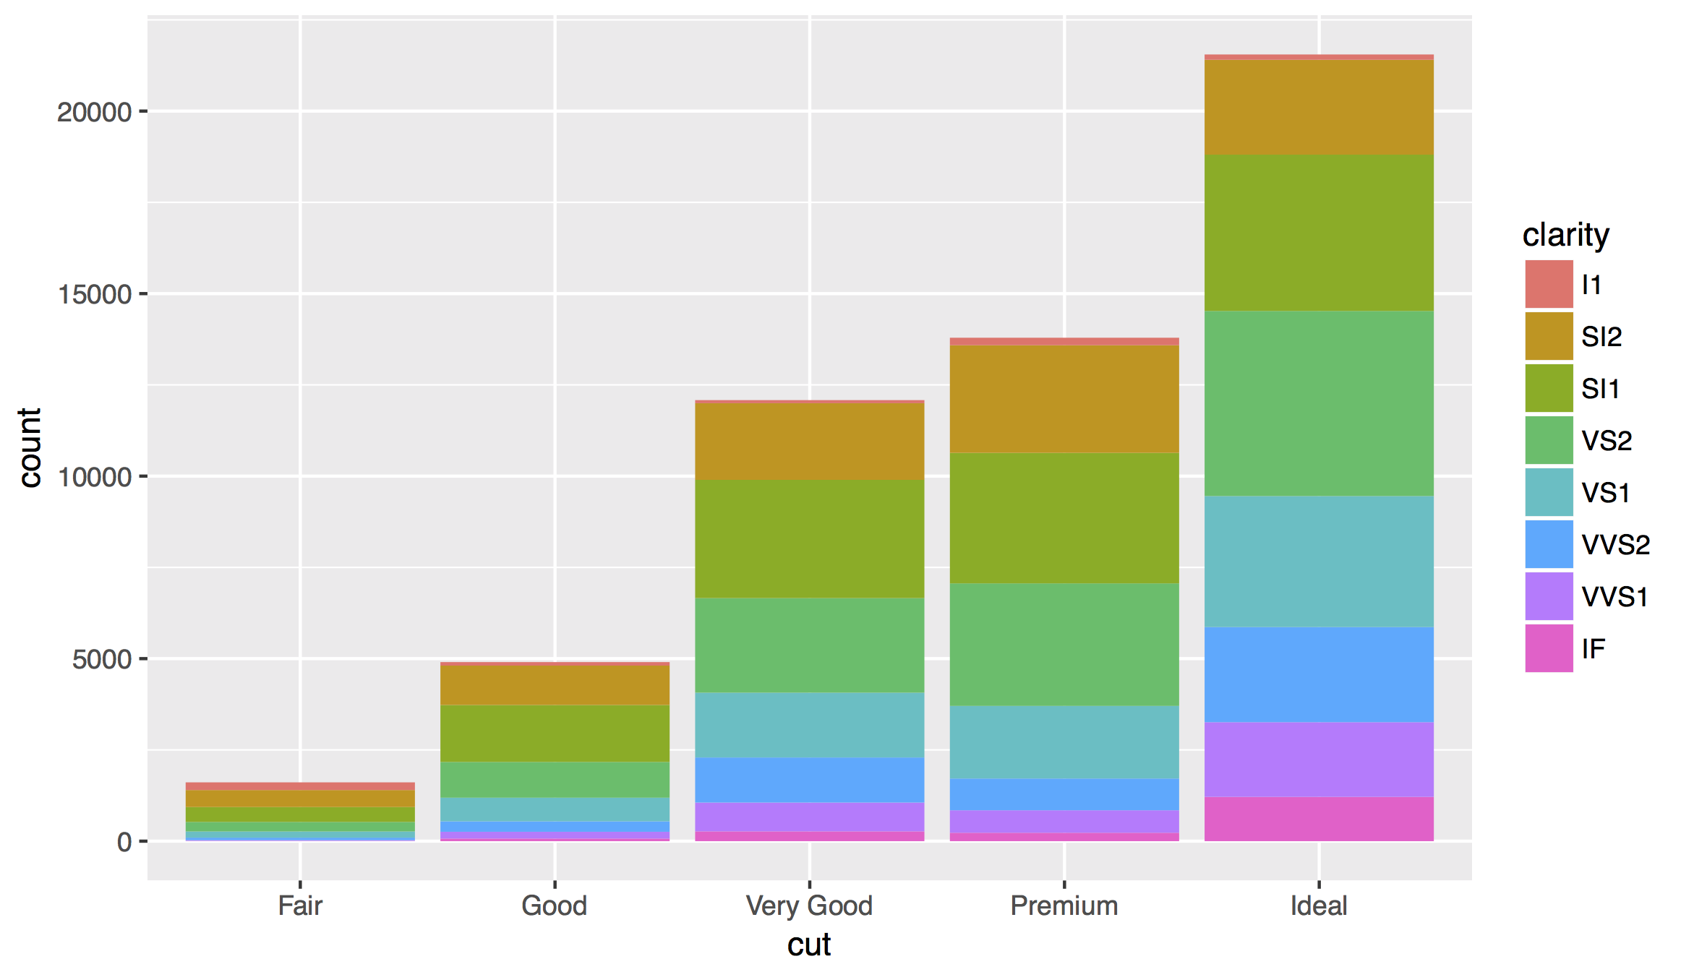

Slide 84
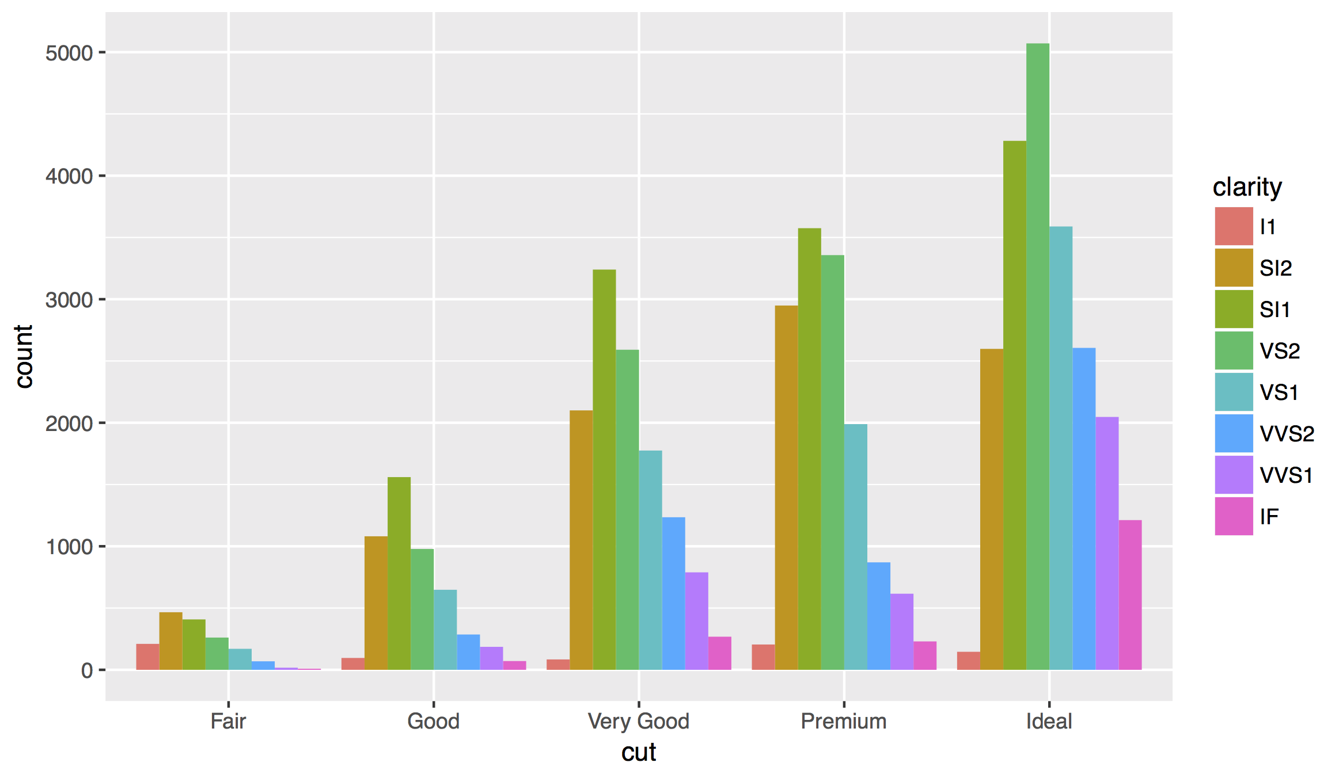
Position Adjustments
How overlapping objects are arranged

Slide 85
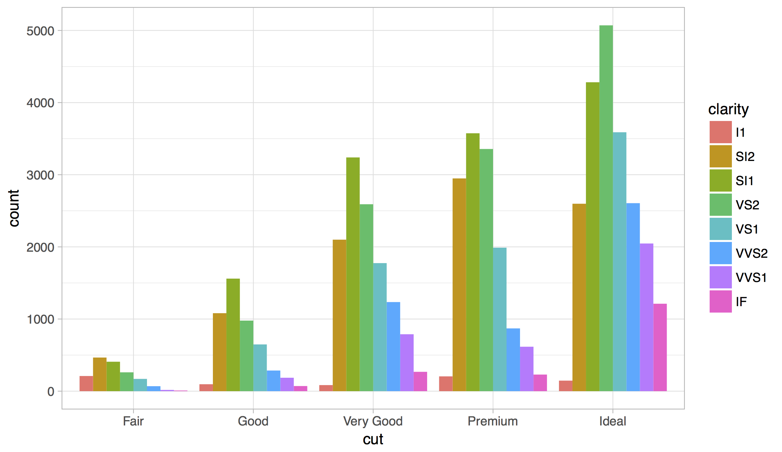
Themes
Visual appearance of non-data elements
+ theme_bw()

Slide 86
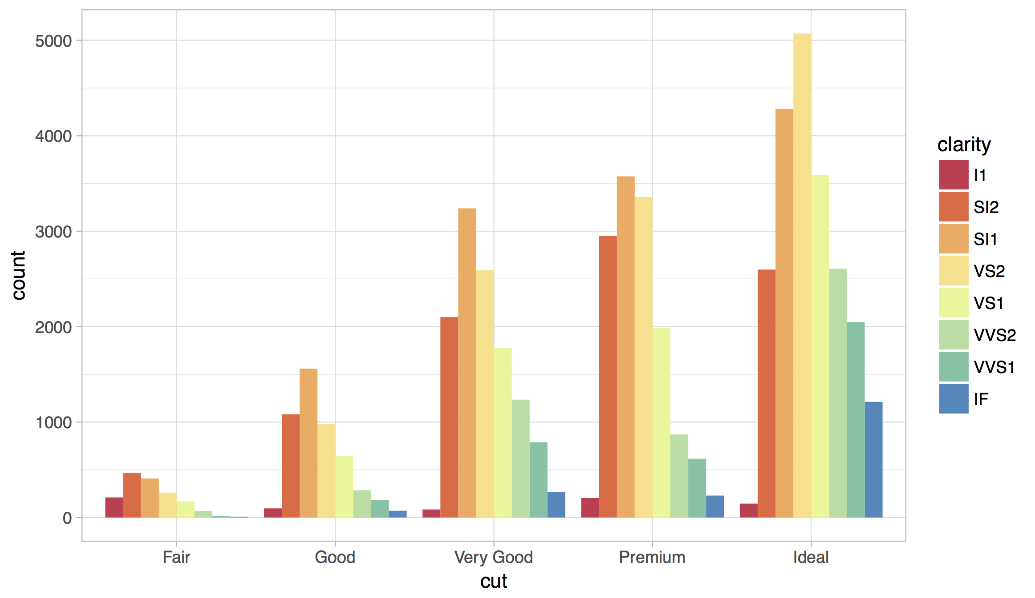
Scales
Customize color scales, other mappings

Slide 87
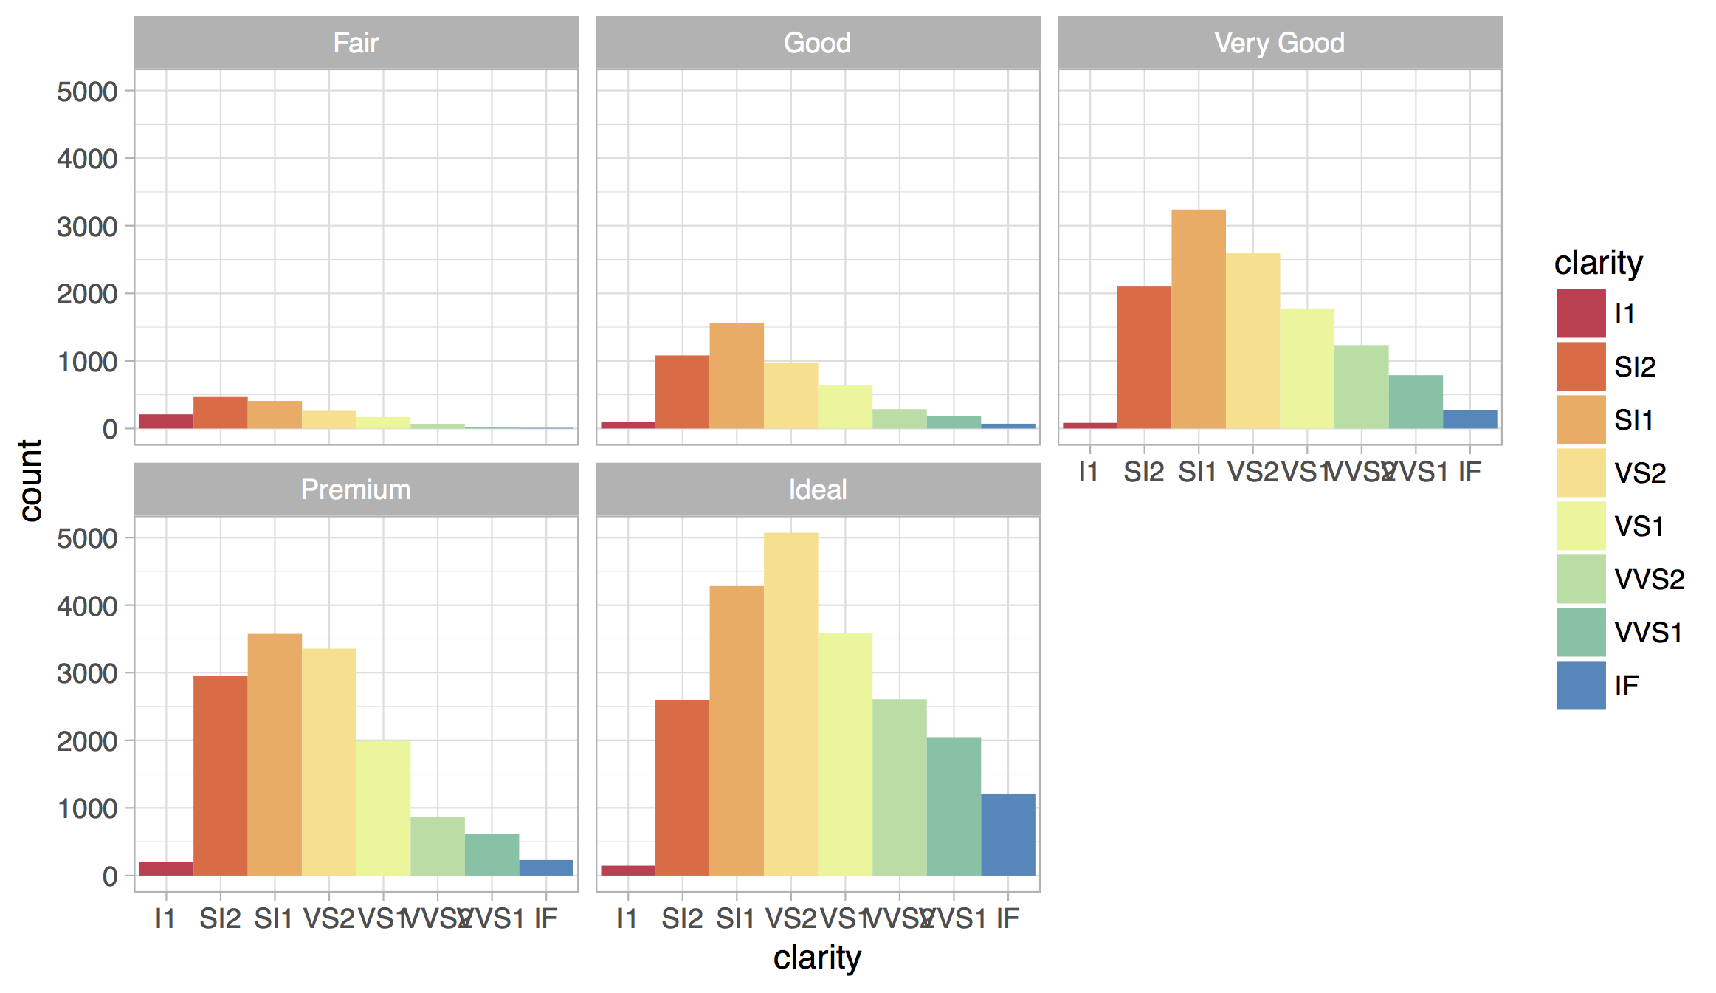
Facets
Subplots that display subsets of the data.

Slide 88
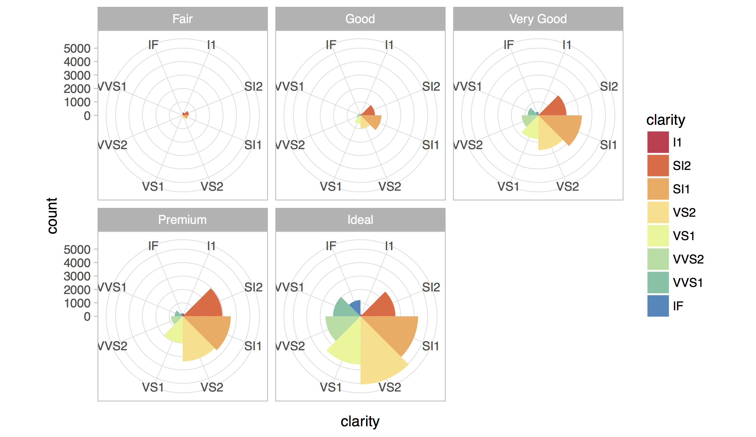
Coordinate systems

Slide 89
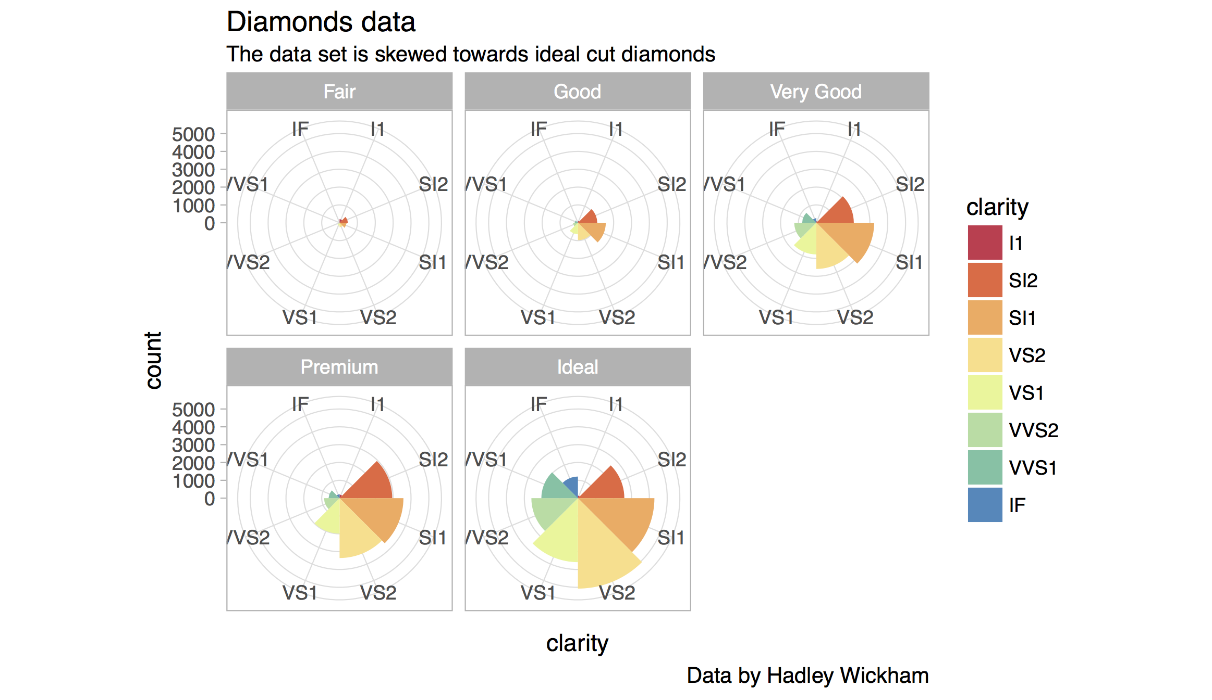
Titles and captions

Slide 90
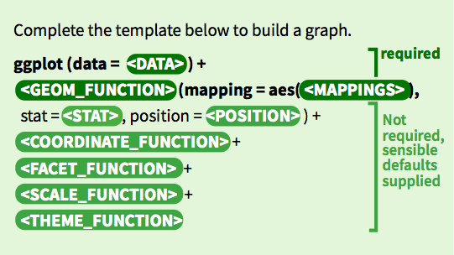
A ggplot2 template
Make any plot by filling in the parameters of this template

Slide 91
David B Sparks, http://bit.ly/hn54NW

Slide 92
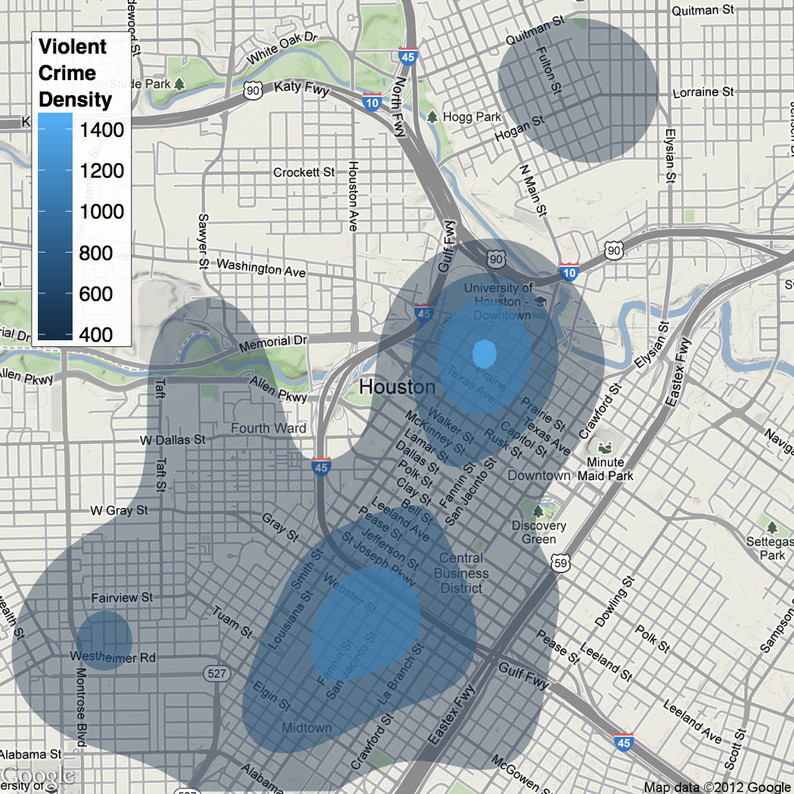
David Kahle, https://dl.dropbox.com/u/24648660/ggmap%20useR%202012.pdf

Slide 93
James Cheshire, http://bit.ly/xqHhAs

Slide 94


r4ds.had.co.nz
The ultimate resource for all of today
Complete and free online

Slide 95
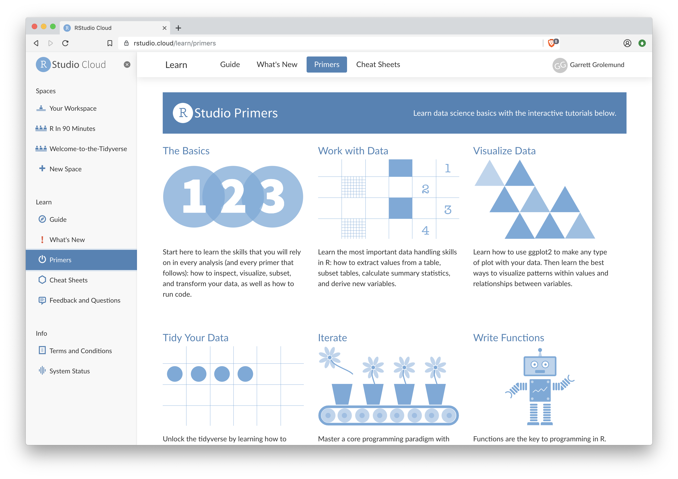
rstudio.cloud/learn/primers
Click Primers in the sidebar

Slide 96
Your Turn
Navigate up to the 03-Transform folder.
Open 03-Transform-Exercises.Rmd

Slide 97
Visualize Data with

